Slide 1
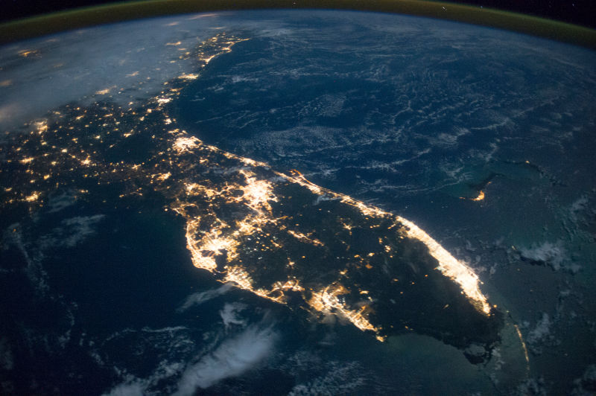
Uniting Business for Good
Florida’s Changing Economic, and Demographic Landscape and Why Business Matters

Slide 2



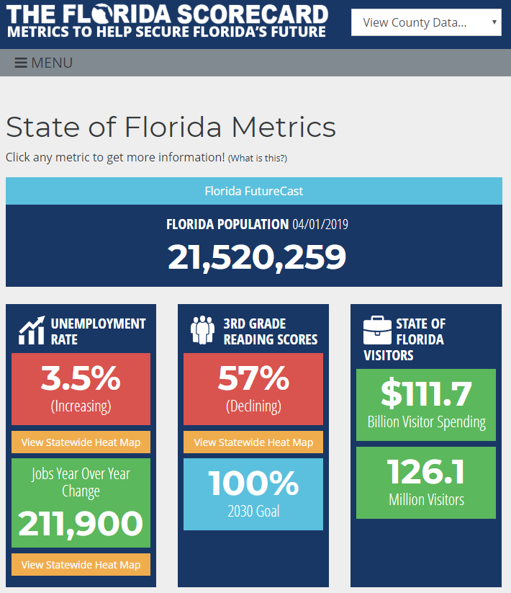
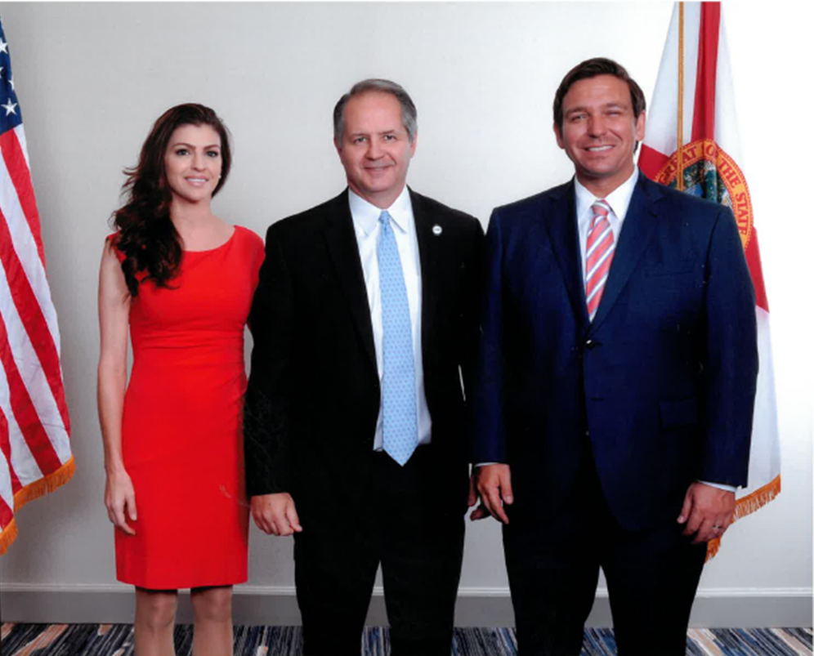
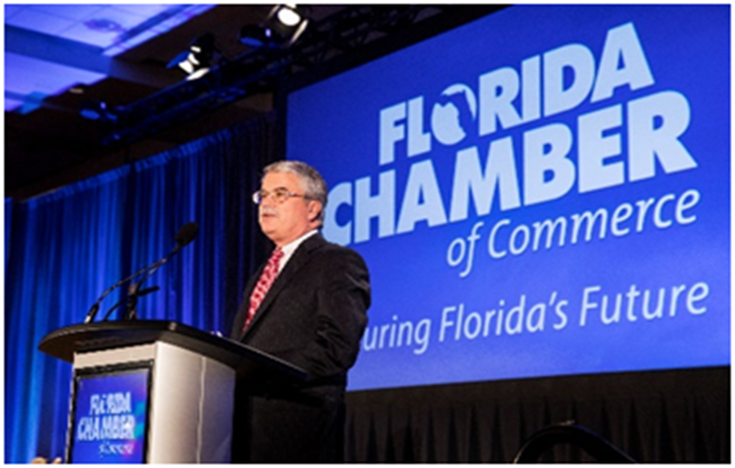
Uniting Business For Good
Solutions (Research)
Actions (Lobbying & Grassroots)
Leadership (Elections)

Slide 3
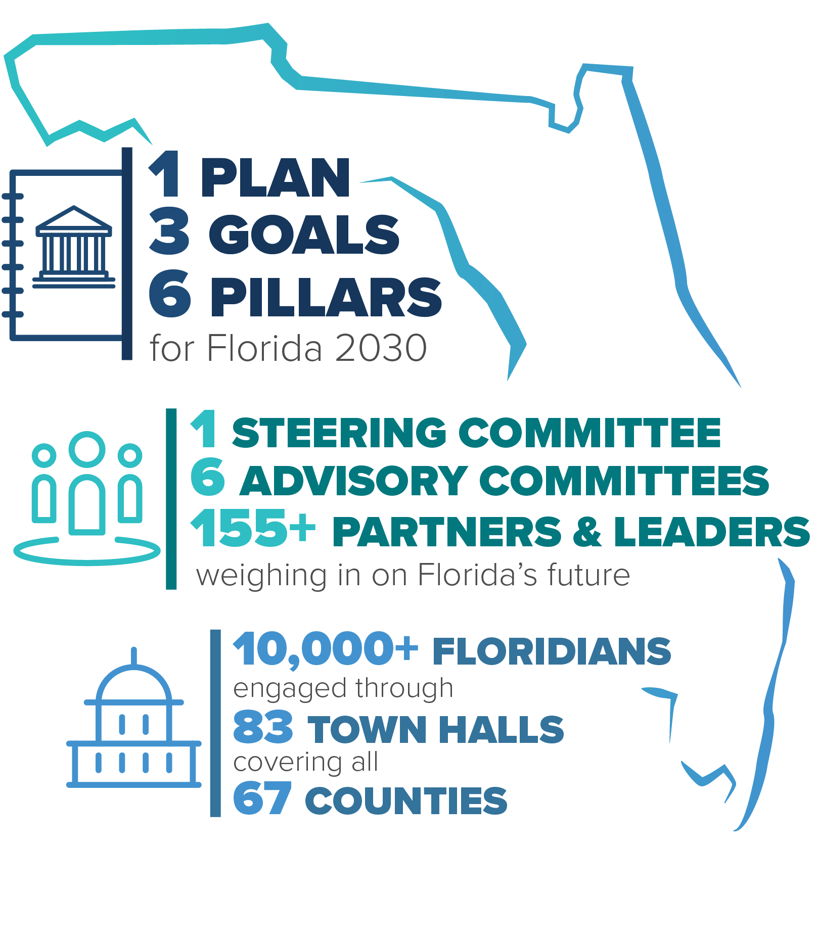

Slide 4
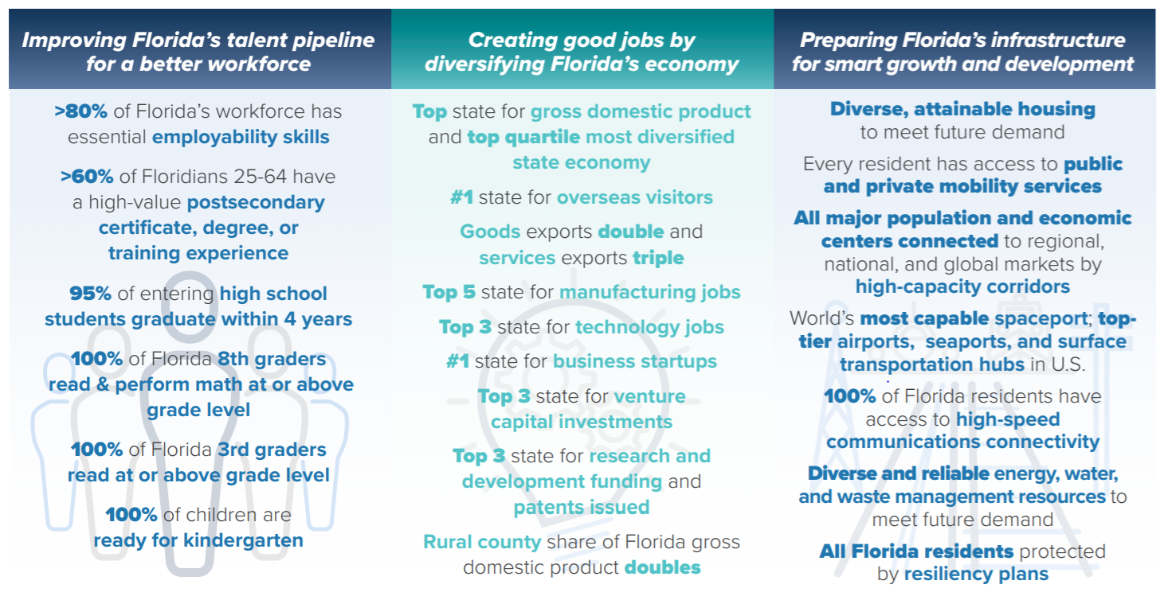


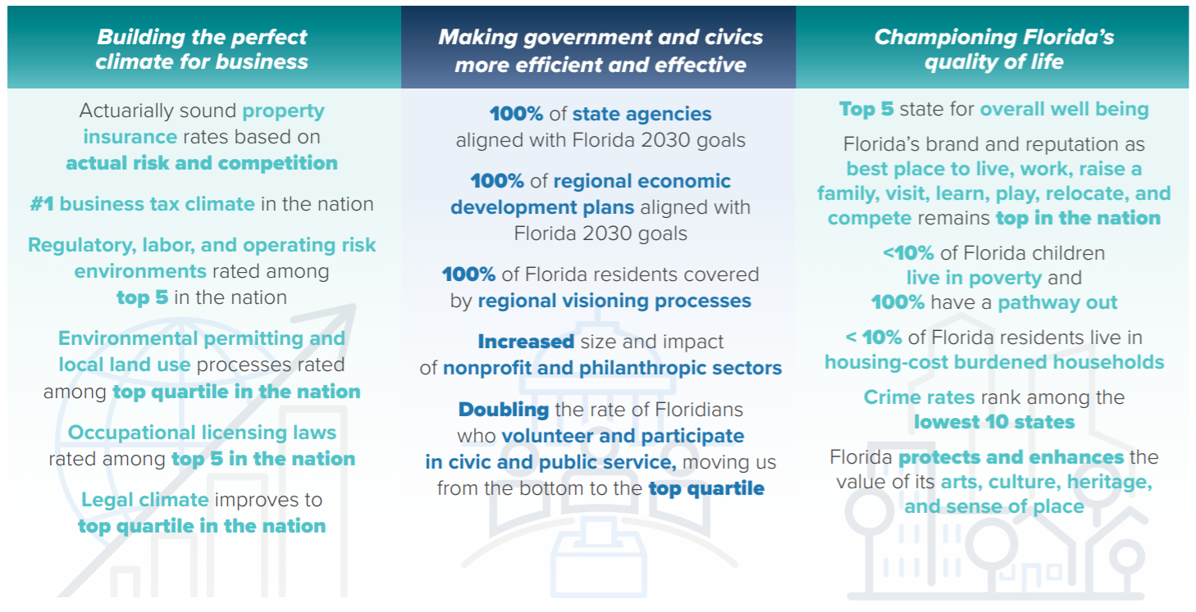

Coordinates

Slide 5
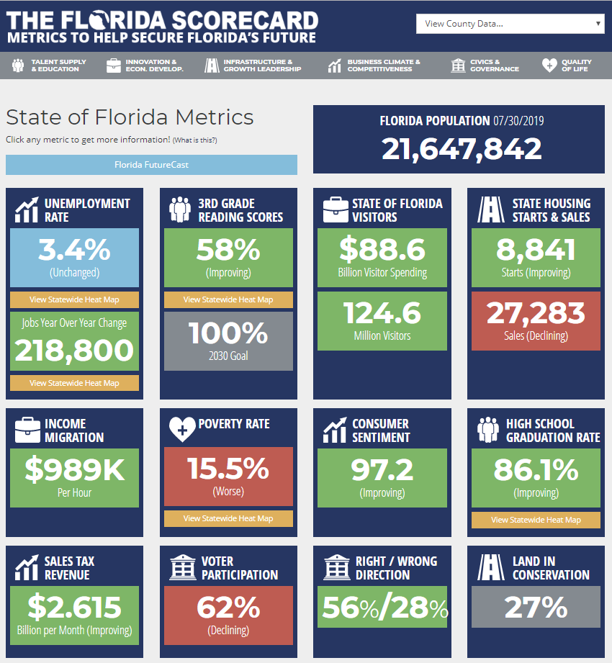
Florida At A Glance
Florida’s Economy $1.07 Trillion GDP (17th)
21.6 Million Residents
  3rd / 26M By 2030 / Around 900 per Day
124.6 Million Visitors In 2018 paid $12 billion taxes
Florida’s Income Migration $989k/hour
289,700 Jobs Looking for People. 349,000 People Looking for Jobs
www.TheFloridaScorecard.org

Slide 6
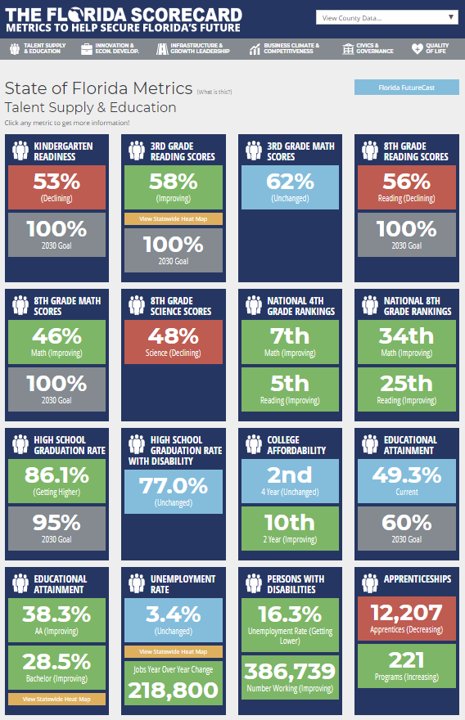

Slide 7
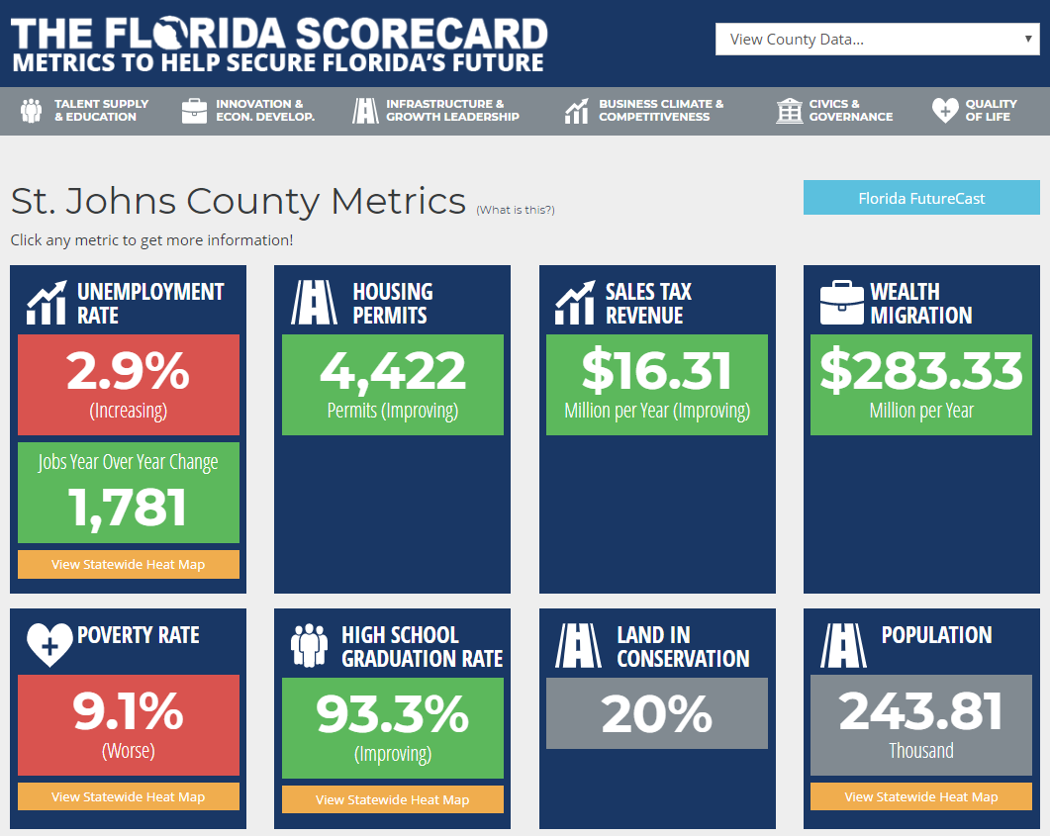

Slide 8
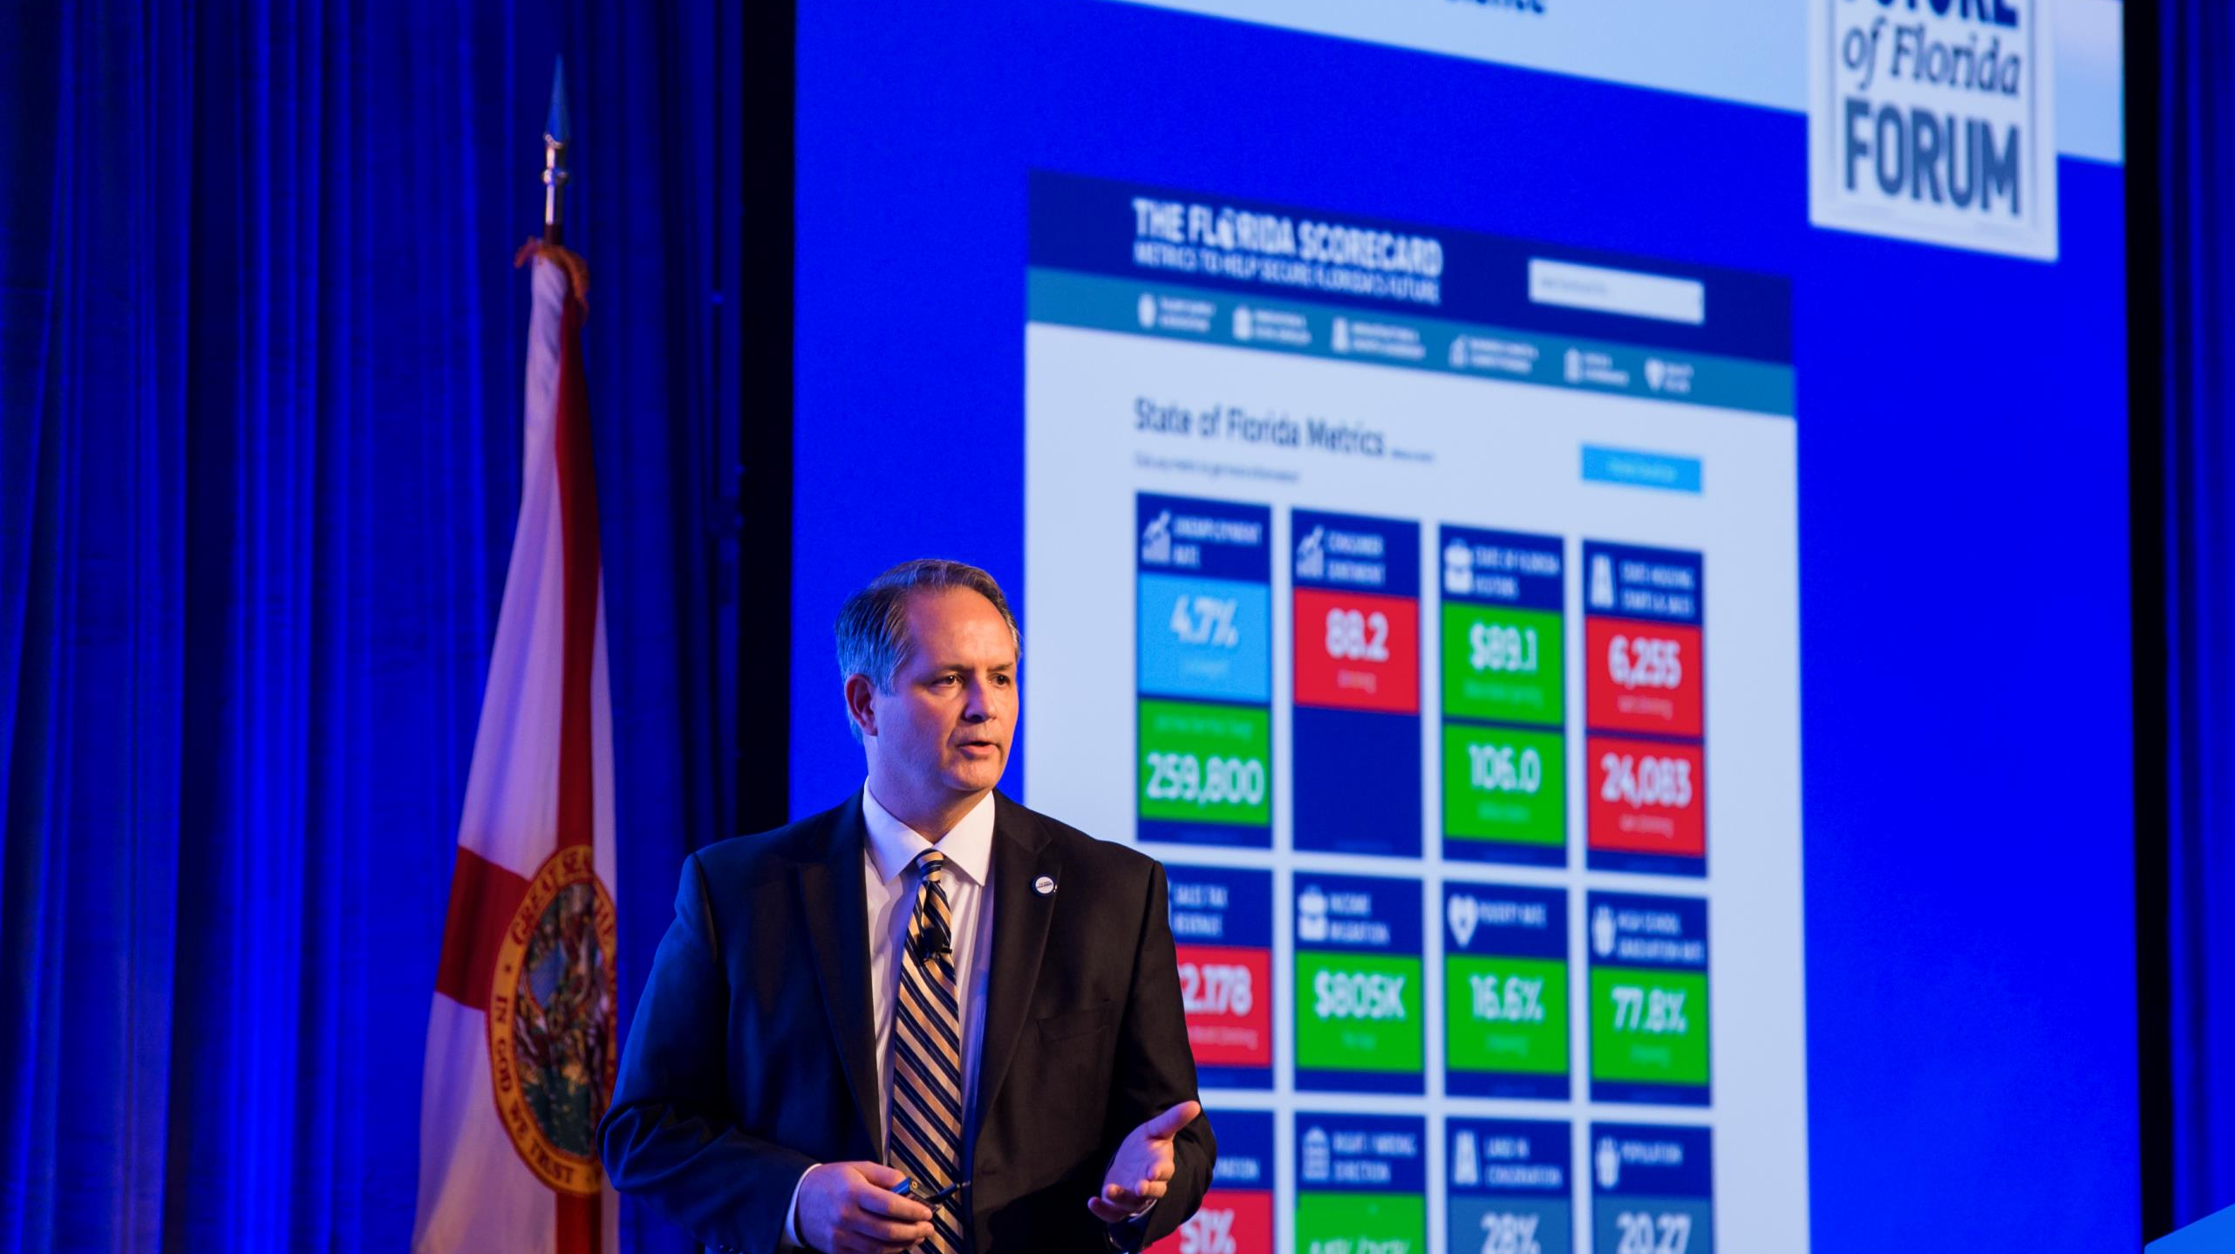
“Florida is changing. Our ECONOMICS, our demographics and our politics are all changing and these changes are both opportunities and challenges.” – Mark Wilson
“Our mission is to lead Florida to a new and sustainable economy.”

Slide 9
Florida and U.S. Job Growth
Job Growth from
June ‘18 to June ‘19:
Florida: 2.5%
U.S.: 1.5%

Slide 10
Industry | Jobs – June 2018 thru June 2019 | Percent Growth
Education & Health Services | 54,700 | 4.2%
Professional & Business Services | 40,500 | 3.0%
Leisure & Hospitality | 31,200 | 2.6%
Construction | 25,800 | 4.8%
Trade, Transportation & Utilities | 18,800 | 1.1%
Financial Activities | 17,400 | 3.0%
Manufacturing | 10,500 | 2.8%

Slide 11
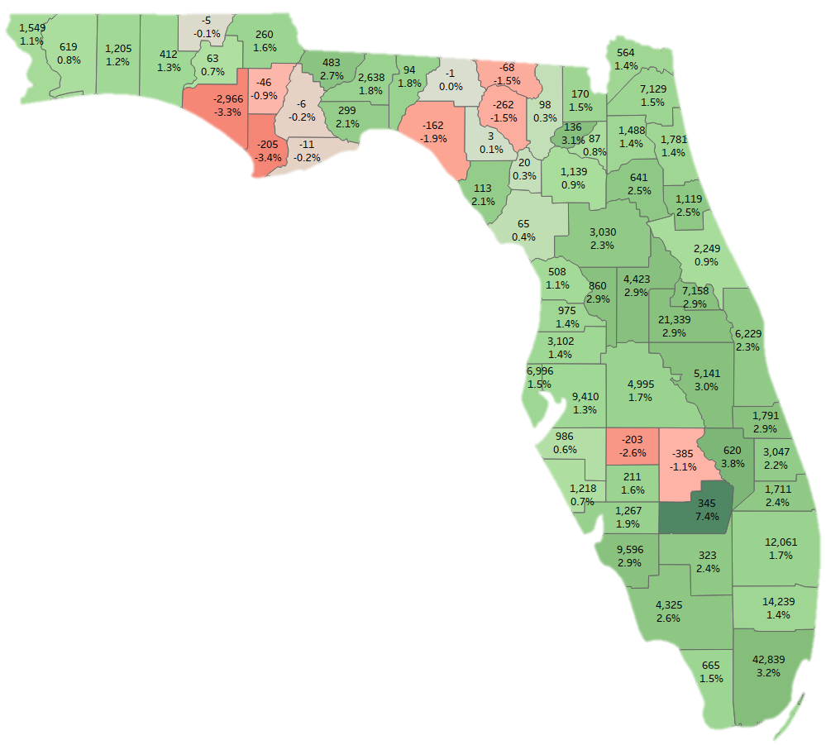
Job Creation
June 2018 – June 2019
U.S. Growth Rate 1.5% Florida Growth Rate 2.5%
Top Counties for Jobs
1. Miami-Dade 42,839
2. Orange 21,339
3. Broward 14,239
4. Palm Beach 12,061
5. Lee 9,596
Hillsborough 9,410
Seminole 7,158
Duval 7,129
Pinellas 6,996
Brevard 6,229
Top Counties for Job Growth
Glades 7.4%
Okeechobee 3.8%
Miami-Dade 3.2%
Union 3.1%
Osceola 3.0%
Lake 2.9%
Orange 2.9%
Lee 2.9%
Sumter 2.9%
Indian River 2.9%
12 Florida counties lost jobs over the past year
Data Source: Florida Department of Economic Opportunity

Slide 12
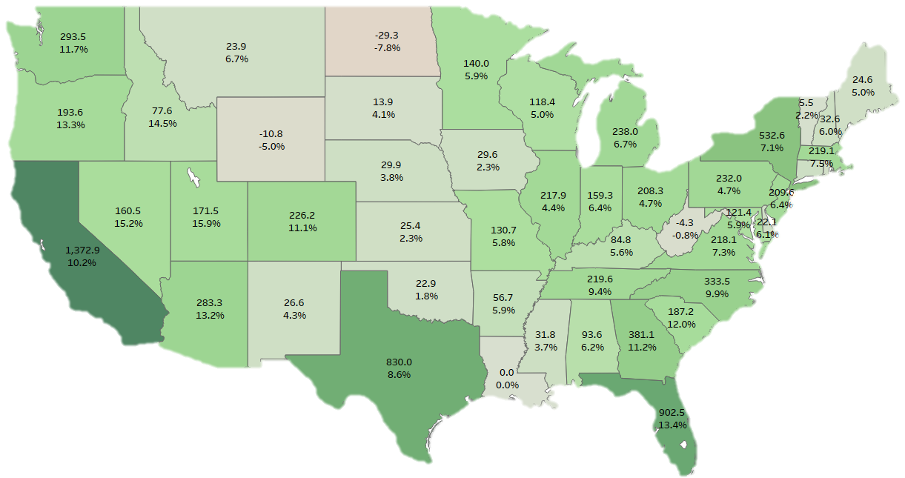
Job Creation by State: 2014-2018
(thousands)
Top States for Job Creation:
California 1,372,943
Florida 902,546
Texas 829,967
New York 532,572
Georgia 381,051
North Carolina 333,493
Washington 293,545
Arizona 283,305
Michigan 238,047
Pennsylvania 232,049
Top Job Growth Rates:
Utah 15.9%
Nevada 15.2%
Idaho 14.5%
Florida 13.4%
Oregon 13.3%
Arizona 13.2%
S. Carolina 12.0%
Washington 11.7%
Georgia 11.2%
Colorado 11.1%
5 States had zero or negative job growth: Louisiana (0), West Virginia (-4,295),
Alaska (-7,255), Wyoming (-10,847), North Dakota (-29,294)
Data Source: Quarterly Census of Employment & Wages, BLS

Slide 13
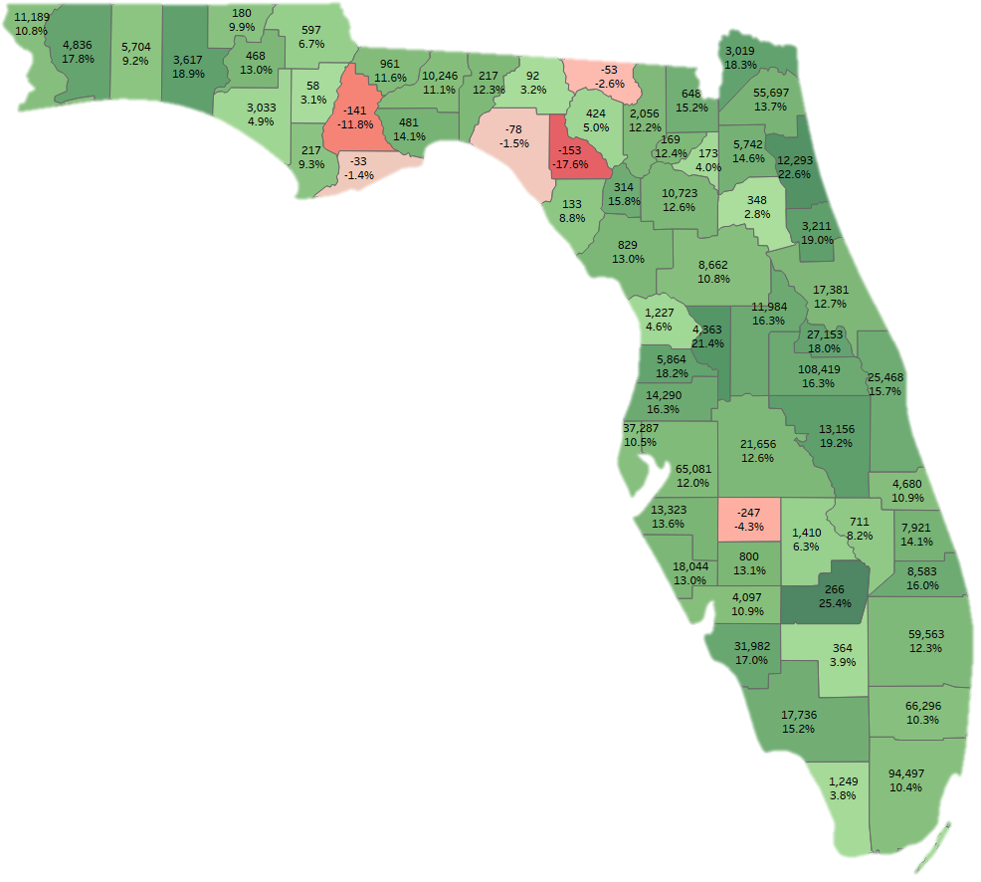
Job Creation
by County: 2014-18
U.S. Job Growth: 7.8%
Florida Job Growth: 13.4%
Top Counties for Jobs
Orange 108,419
Miami-Dade 94,497
Broward 66,296
Hillsborough 65,081
Palm Beach 59,563
Duval 55,697
Pinellas 37,287
Lee 31,982
Seminole 27,153
Brevard 25,468
Top Counties for Job Growth
Glades 25.4%
St. Johns 22.6%
Sumter 21.4%
Osceola 19.2%
Flagler 19.0%
Walton 18.9%
Nassau 18.3%
Hernando 18.2%
Seminole 18.0%
Santa Rosa 17.8%
6 Florida Counties Lost Jobs: Franklin, Taylor, Hamilton, Hardee, Liberty, Lafayette
Data Source: Quarterly Census of Employment & Wages, BLS

Slide 14
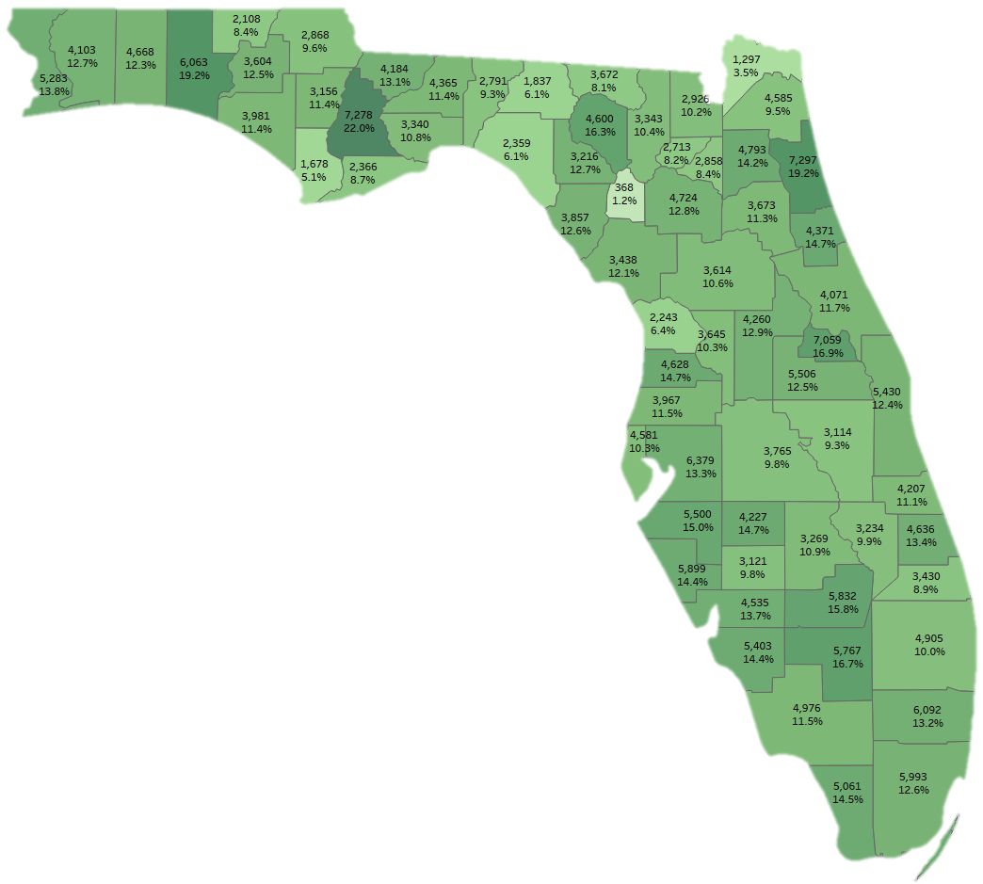
Average Annual Wage
Growth by County: 2014-18
U.S. Wage Growth: 11.5%
Florida Wage Growth: 12.2%
Top Annual Wage Growth:
St. Johns 7,297
Liberty 7,278
Seminole 7,059
Hillsborough 6,279
Broward 6,092
Walton 6,063
Miami-Dade 5,993
Sarasota 5,899
Glades 5,832
Hendry 5,767
Top Percentage Wage Growth:
Liberty 22.0%
Walton 19.2%
St. Johns 19.2%
Seminole 16.9%
Hendry 16.7%
Suwannee 16.3%
Glades 15.8%
Manatee 15.0%
Flagler 14.7%
Hernando 14.7%
Data Source: Quarterly Census of Employment & Wages, BLS

Slide 15
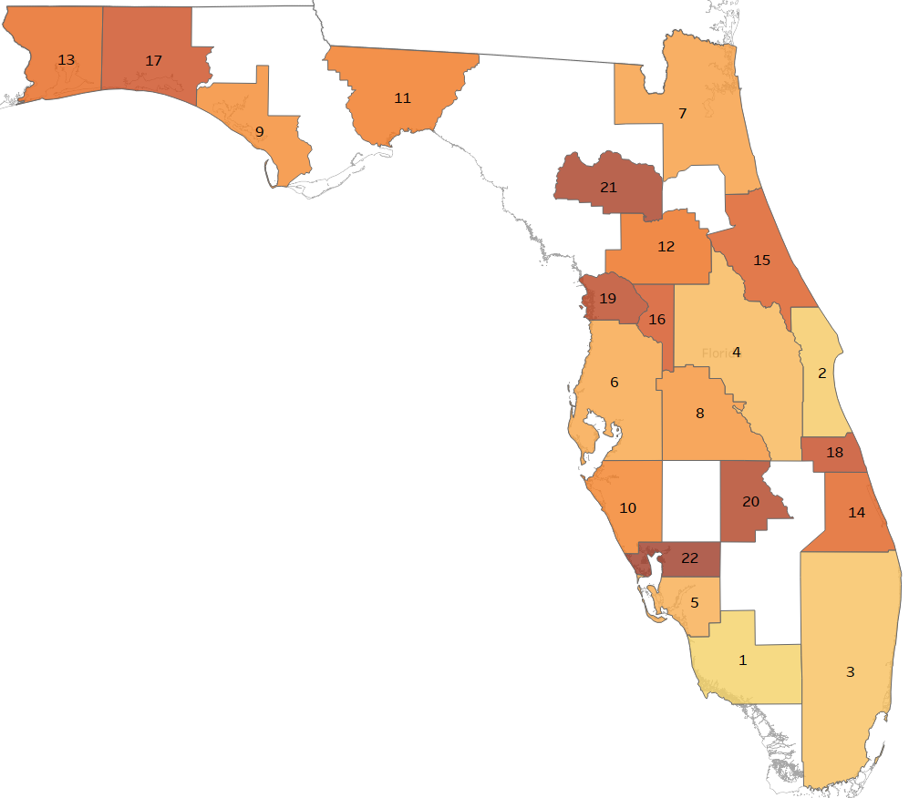
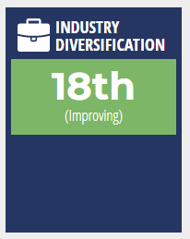
Florida
Industry Diversification by MSA
Diversification Rankings
#1 Naples-Immokalee-Marco Island MSA
#2 Palm Bay-Melbourne-Titusville MSA
#3 Miami-Ft. Lauderdale-West Palm Beach MSA
#4 Orlando-Kissimmee-Sanford MSA
#5 Cape Coral-Ft. Myers MSA
#6 Tampa-St. Petersburg-Clearwater MSA
#7 Jacksonville
#8 Lakeland-Winter Haven
#9 Panama City
#10 North Port-Sarasota-Bradenton
Data Source: Florida Gulf Coast University, Regional Economic Research Institute. Q4 2018 data

Slide 16
“Florida is changing. Our economics our DEMOGRAPHICS and our politics are all changing and these changes are both opportunities and challenges.” – Mark Wilson
“Our mission is to lead Florida to a new and sustainable economy.”

Slide 17
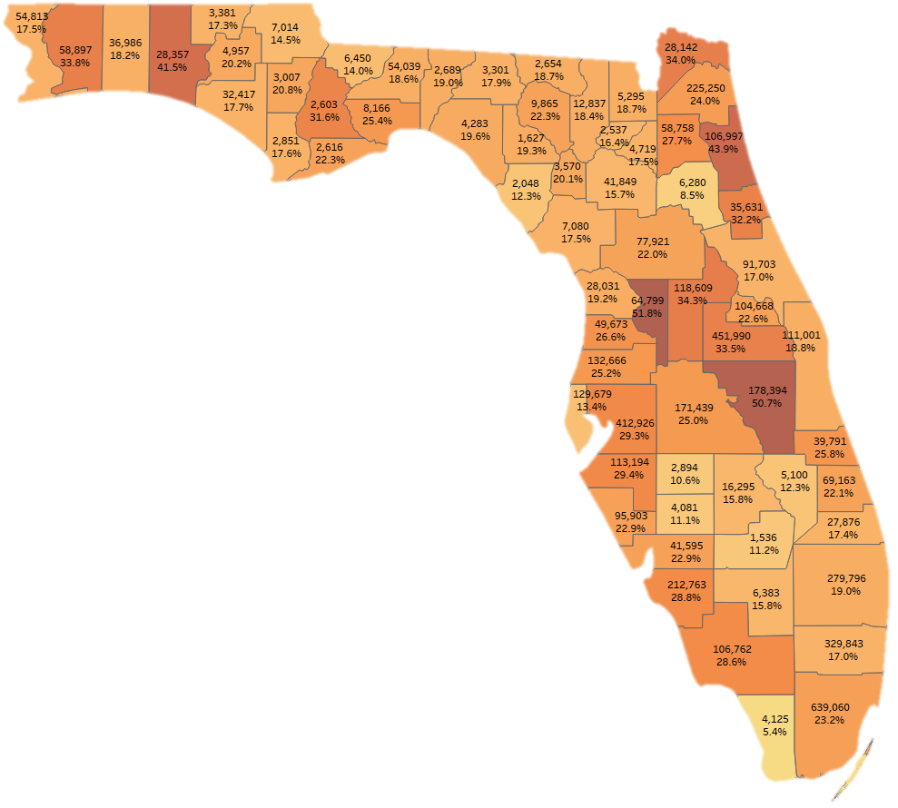
Florida’s Next
4.5 Million People
Top 10 Growth in People
Miami-Dade 639,060
Orange 451,990
Hillsborough 412,926
Broward 329,843
Palm Beach 279,976
Duval 225,250
Lee 212,763
Osceola 178,394
Polk 171,439
Pasco 129,769
Top 10 Growth in Percent
Sumter 51.8%
Osceola 50.7%
St. Johns 43.9%
Walton 41.5%
Lake 34.3%
Nassau 34.0%
Santa Rosa 33.8%
Orange 33.5%
Flagler 32.2%
Liberty 31.6%
The top 3 Counties get 33.4% of the Growth:
Top 6: 52.0%
Top 11: 70.3%
Top 13: 75.5%
Data Source: Bureau of Economic and Business Research (BEBR) Population Studies Group, University of Florida

Slide 18
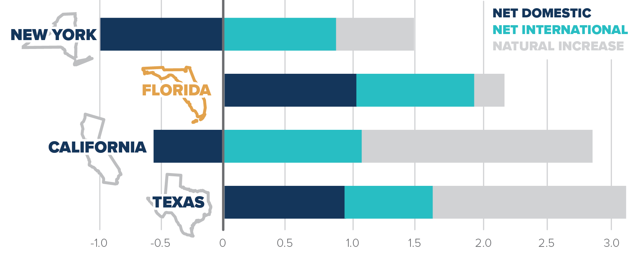
Where Does Florida’s Growth Come From?
Change in Population by Source, 2010-2017 (millions)

Slide 19
Age Group
85+
Growth to 2030 by Age Group
80-84
75-79
70-74
65-69
60-64
55-59
50-54
45-49
40-44
35-39
30-34
25-29
20-24
15-19
0-14
0%
20%
40%
60%
80%

Slide 21
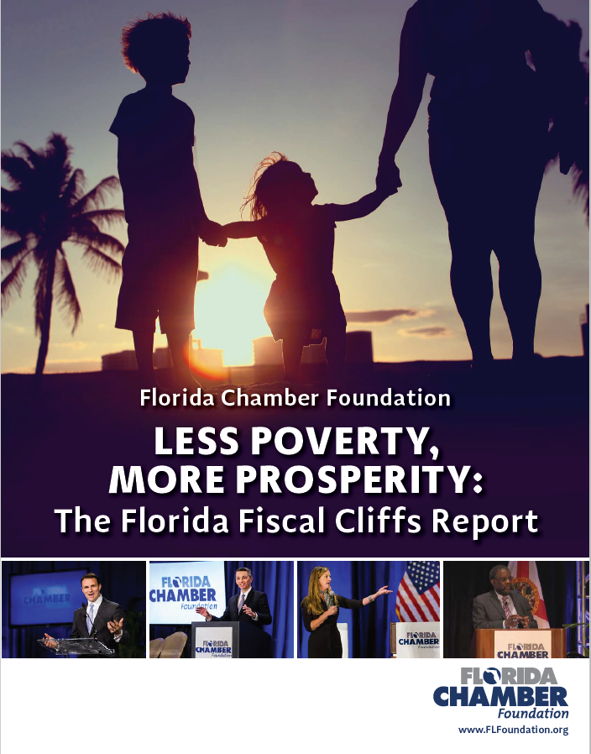
Notes:
Grad students

Slide 22
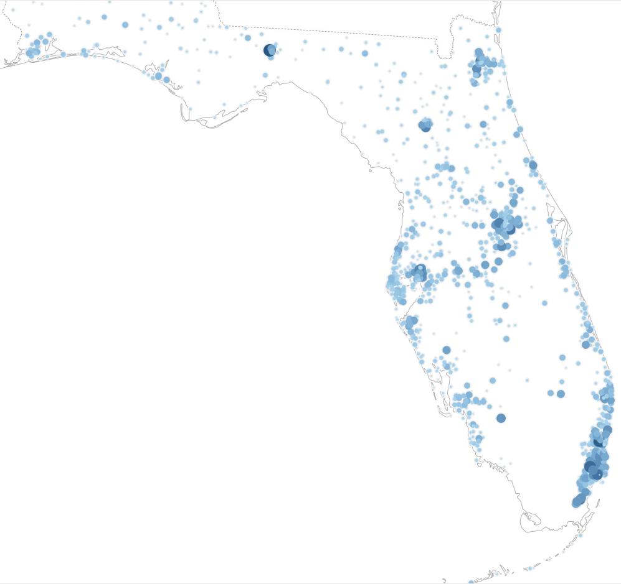
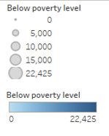
Child Poverty in Florida
901,772 kids under-18 living in poverty, by zip code
“If you eliminated poverty in just 16 of Florida’s 983 populated zip codes, you would eliminate 10 percent of child poverty in Florida”
Top Zip Codes Percent of Poverty
16 10%
39 20%
69 30%
105 40%
148 50%

Slide 23
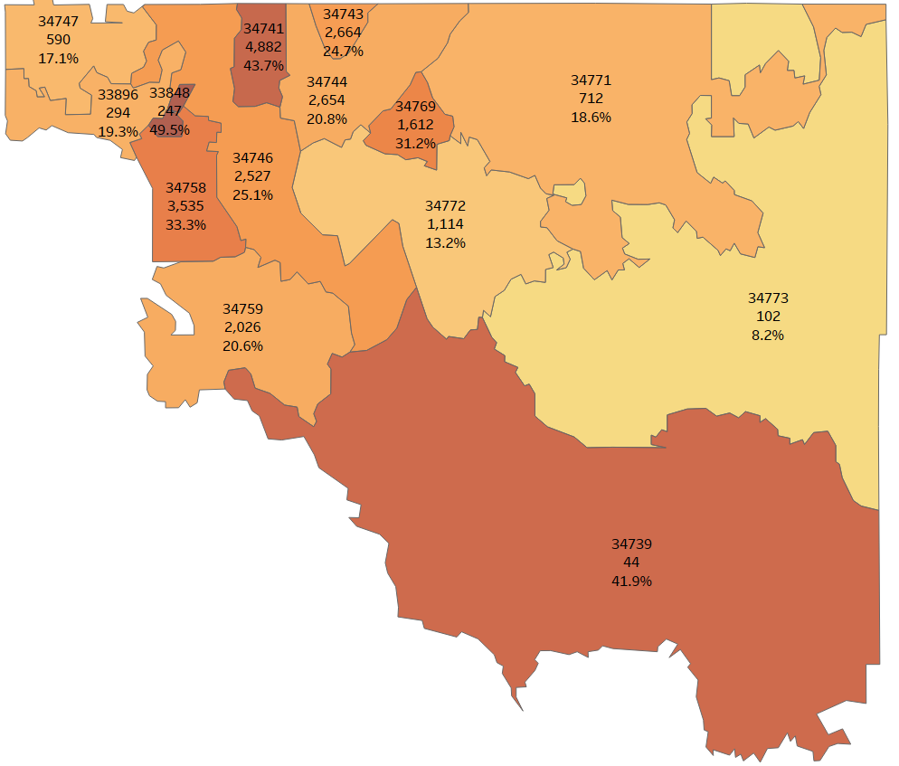
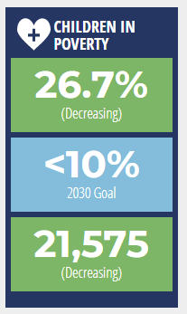
Osceola County:
Under-18 Poverty
21,575 kids in Poverty
26.7% of kids in Osceola County
Top Number: Zip Code
Middle Number: Number of kids in Poverty
Bottom Number: Under-18 Poverty Rate
Data Source: American Community Survey, U.S. Census Bureau. 2017 data

Slide 24
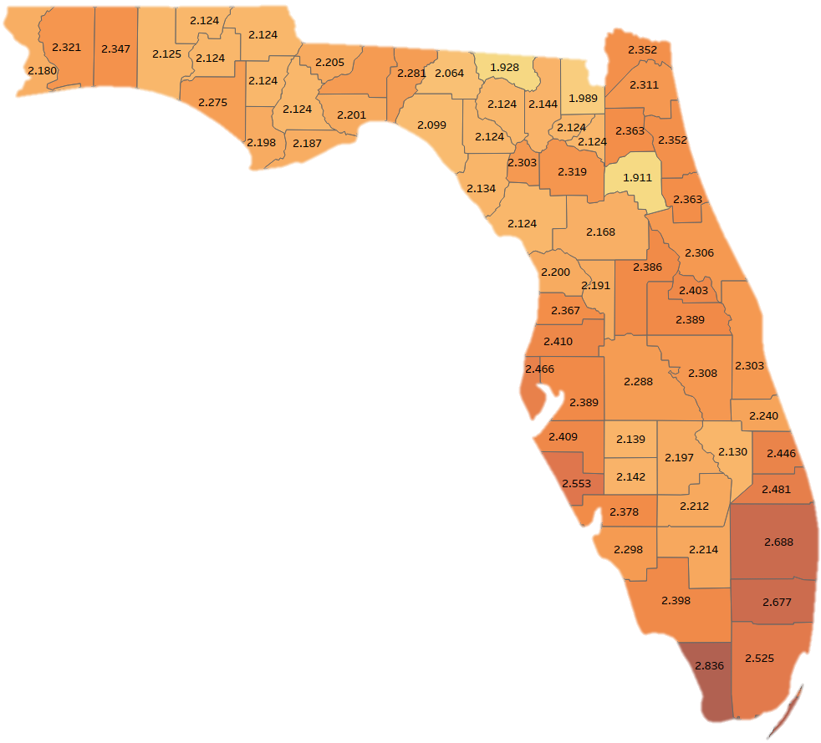
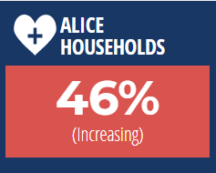
2.27 Florida Average
Data Source: ALICE Report – United Way of Florida; American Community Survey, U.S. Census Bureau.

Slide 25
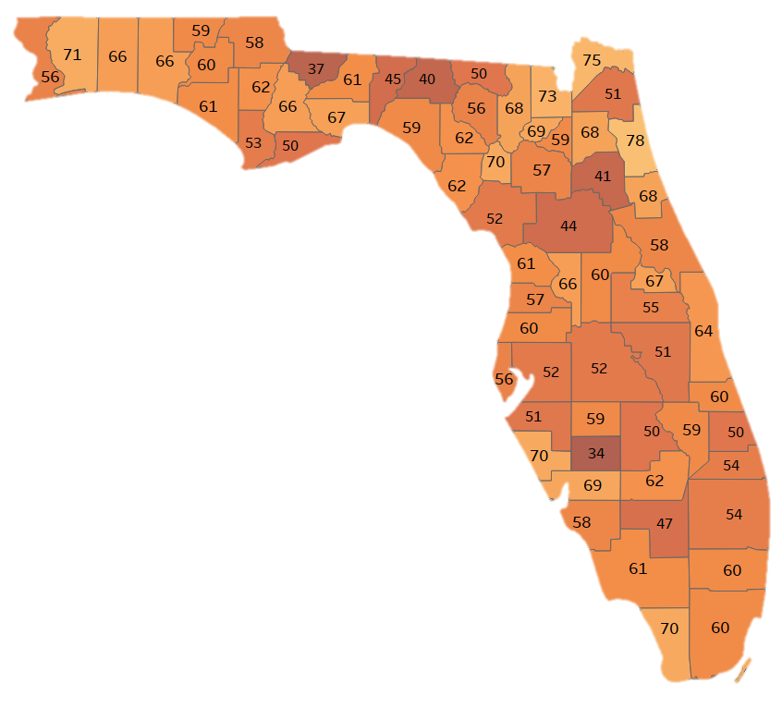
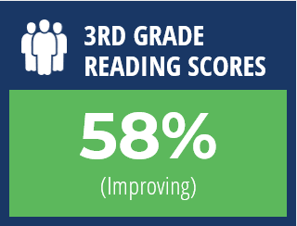
Florida’s 3rd Grade Reading Scores
Number is percent of 3rd Graders reading at or above Grade Level
Statewide: 91,066 public school 3rd Graders not reading at grade level in 2018.
Florida

Slide 26
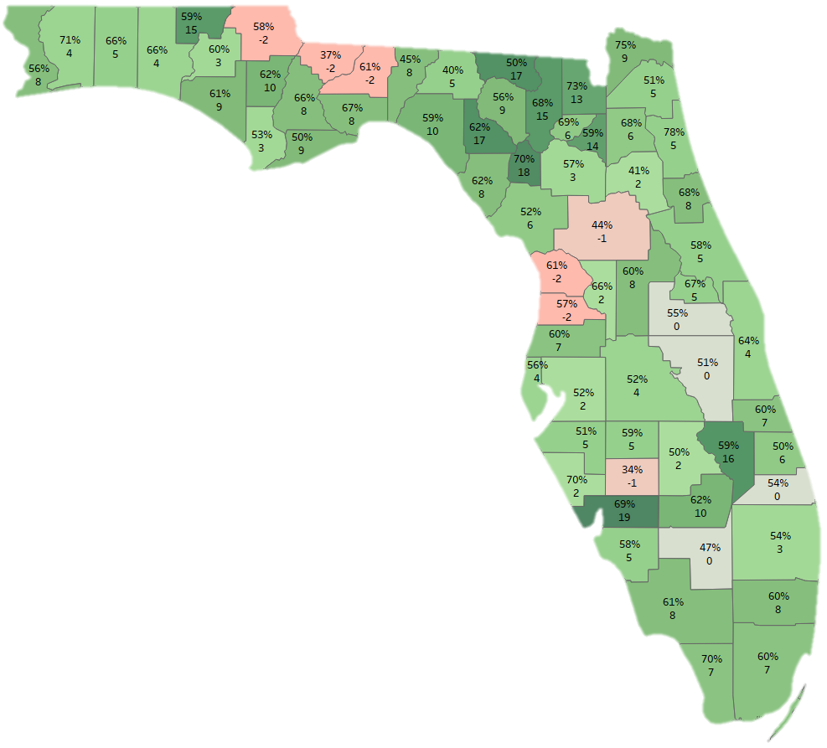
3rd Grade Reading Scores and Changes from 2015-2019
Top Number: 2019 Percent of 3rd graders reading at or above grade level
Bottom Number: Percentage point change from 2015-2019
Florida score went from 53% to 58% during this time period
Top Improvements:
Charlotte 19
Gilchrist 18
Lafayette 17
Hamilton 17
Okeechobee 16
Columbia 15
Holmes 15
Bradford 14
Baker 13
Counties whose scores declined:
Citrus -2
Gadsden -2
Hernando -2
Jackson -2
Leon -2
Marion -1
Desoto -1
Data Source: Florida Department of Education

Slide 27
School | Percent Reading at Grade Level or Above | Kids Not Reading at Grade Level |  | School | Percent Reading at Grade Level or Above | Kids Not Reading at Grade Level
HARMONY COMMUNITY SCHOOL | 70 | 40 |  | BOGGY CREEK ELEMENTARY SCHOOL | 33 | 71
KISSIMMEE ELEMENTARY SCHOOL | 43 | 92 |  | HICKORY TREE ELEMENTARY SCHOOL | 66 | 49
NARCOOSSEE ELEMENTARY SCHOOL | 71 | 53 |  | MILL CREEK ELEMENTARY SCHOOL | 42 | 97
CENTRAL AVENUE ELEMENTARY SCHOOL | 26 | 81 |  | CELEBRATION SCHOOL | 71 | 49
HIGHLANDS ELEMENTARY SCHOOL | 46 | 68 |  | LAKEVIEW ELEMENTARY SCHOOL | 61 | 47
THACKER AVENUE ELEM FOR INTERNATIONAL STUDIES | 43 | 81 |  | PLEASANT HILL ELEMENTARY SCHOOL | 39 | 82
ST. CLOUD ELEMENTARY SCHOOL | 70 | 53 |  | DEERWOOD ELEMENTARY SCHOOL | 30 | 66
RENAISSANCE CHARTER SCHOOL AT POINCIANA | 50 | 43 |  | CYPRESS ELEMENTARY SCHOOL | 44 | 74
FLORIDA CYBER CHARTER ACADEMY AT OSCEOLA | 41 | 24 |  | FOUR CORNERS CHARTER SCHOOL | 55 | 70
AVANT GARDE ACADEMY K8 OSCEOLA | 33 | 18 |  | KISSIMMEE CHARTER ACADEMY | 68 | 24
ST. CLOUD PREPARATORY ACADEMY | 65 | 16 |  | P. M. WELLS CHARTER ACADEMY | 44 | 44
MATER BRIGHTON LAKES | 52 | 51 |  | POINCIANA ACADEMY OF FINE ARTS | 38 | 67
RENAISSANCE CHARTER SCHOOL AT TAPESTRY | 38 | 84 |  | PARTIN SETTLEMENT ELEMENTARY SCHOOL | 52 | 74
OSCEOLA SCIENCE CHARTER SCHOOL | 69 | 18 |  | CANOE CREEK CHARTER ACADEMY | 51 | 35
MATER PALMS ACADEMY | 62 | 11 |  | FLORA RIDGE ELEMENTARY SCHOOL | 38 | 95
RENAISSANCE CHARTER SCHOOL AT BOGGY CREEK | 30 | 28 |  | BELLALAGO CHARTER ACADEMY | 63 | 46
MICHIGAN AVENUE ELEMENTARY SCHOOL | 57 | 42 |  | NEPTUNE ELEMENTARY SCHOOL | 49 | 82
KOA ELEMENTARY SCHOOL | 44 | 65 |  | CHESTNUT ELEM SCHOOL SCIENCE AND ENGINEERING | 61 | 43
REEDY CREEK ELEMENTARY SCHOOL | 49 | 108 |  | SUNRISE ELEMENTARY SCHOOL | 50 | 82
WESTSIDE K-8 SCHOOL | 47 | 101 |  | EAST LAKE ELEMENTARY SCHOOL | 60 | 69
VENTURA ELEMENTARY SCHOOL | 47 | 74 |  | Osceola County | 51% | 2,417
Data Source: Florida Department of Education, 2018 data.

Slide 28
Notes:
The first report from the Florida 2030 project is called “Florida Jobs 2030”.
Thankful for the support from the Bill & Melinda Gates Foundation for this project.
In this report, more than 90 stakeholders from all areas of Florida were interviewed.
Included:
Private-sector companies, both large and small businesses
Professionals involved in career training and development
State college, and state university leaders
Economic Development Professionals
Non-profit leaders
Many local chambers of commerce
Foundations who work in this field
Association partners
Results from these hundreds of hours of interviews were combined with quantitative data on the number of jobs available in categories chosen for their growth potential in this state and their ability to provide high-wage jobs and career options for Florida families.

Slide 29
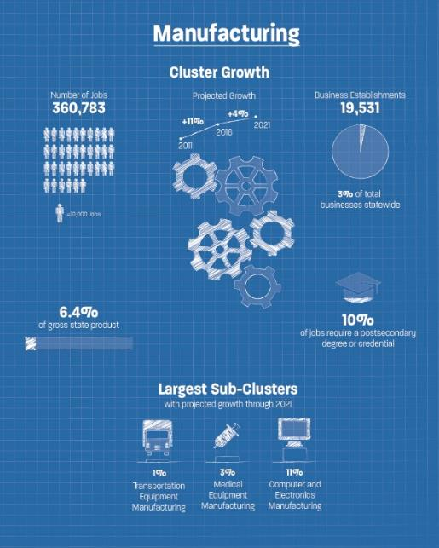
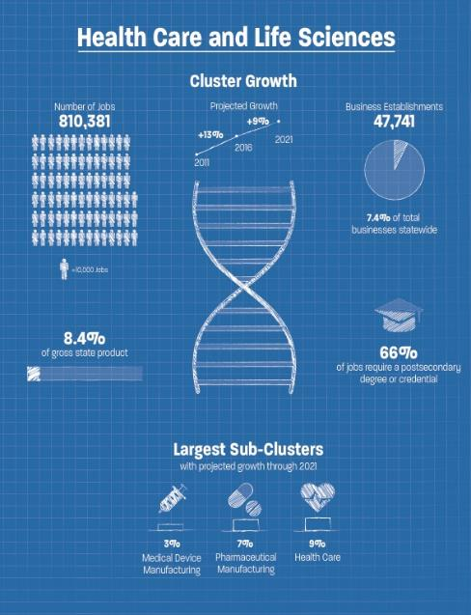
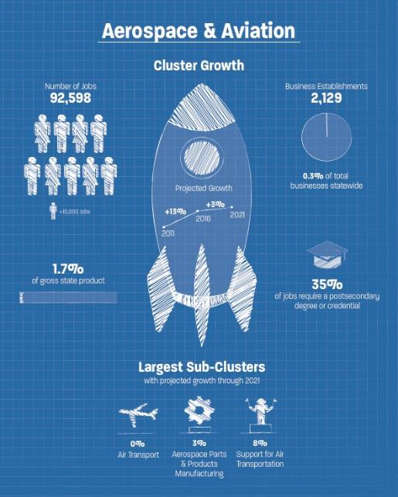
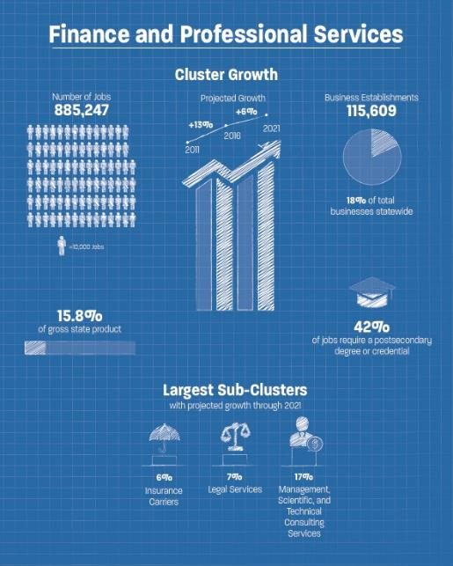
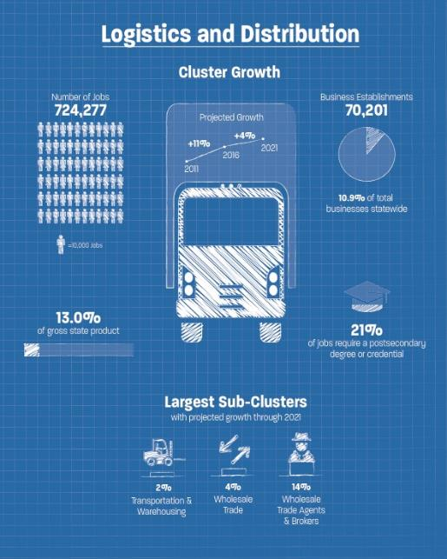

Slide 30
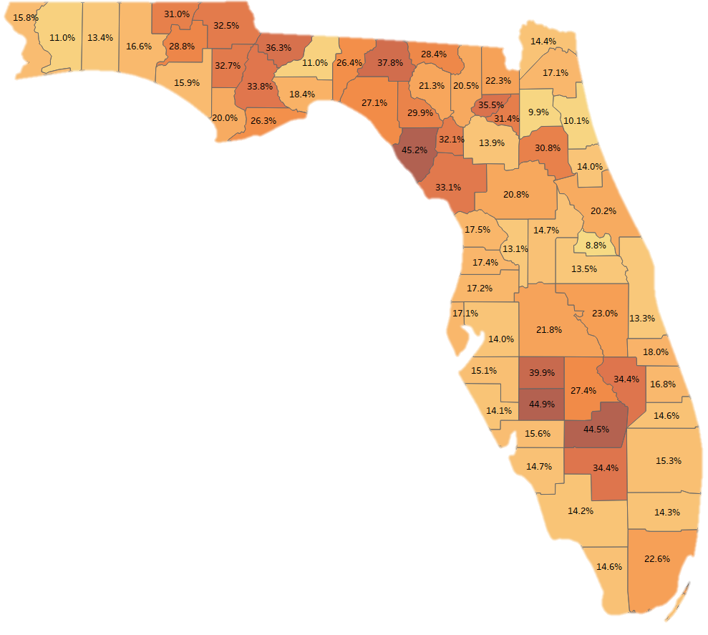
1.26 million Florida households
do not have internet access
Florida Average: 16.8%
6,713
Counties with highest percent not having internet access :
1. Dixie 45.2% 8. Okeechobee 34.4%
2. Desoto 44.9% 9. Hendry 34.4%
3. Glades 44.5% 10. Liberty 33.8%
4. Hardee 39.9% 11. Levy 33.1%
5. Madison 37.8% 12. Calhoun 32.7%
6. Gadsden 36.3% 13. Jackson 32.5%
7. Union 35.5% 14. Gilchrist 32.1%
Data Source: American Community Survey, U.S. Census Bureau

Slide 31
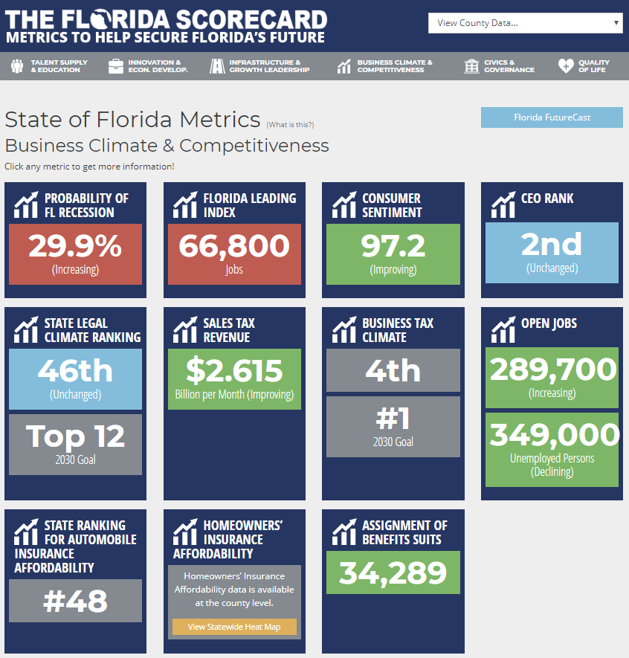

Slide 32
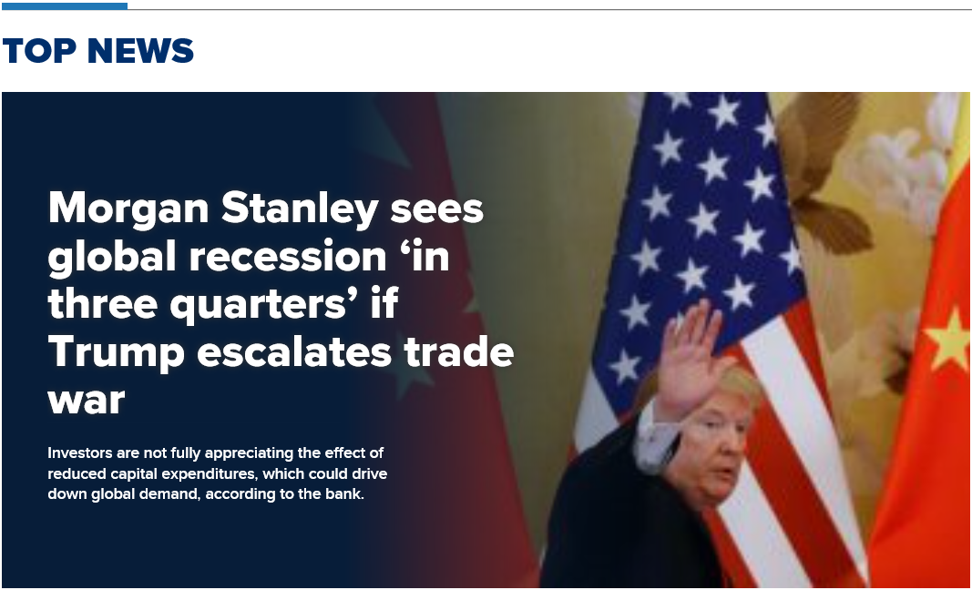
Source: cnbc.com – 2 June, 2019

Slide 33
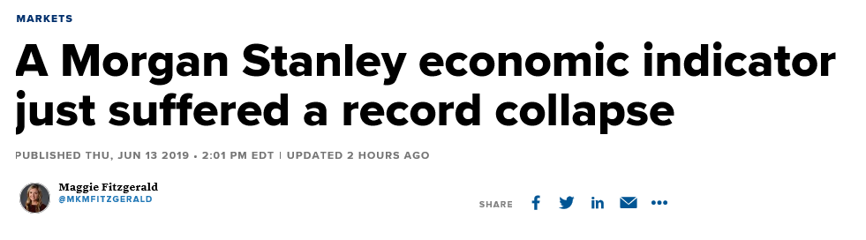
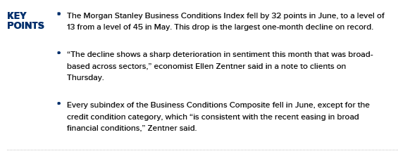

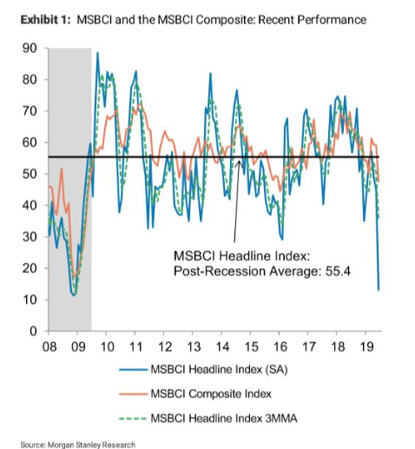

Slide 34
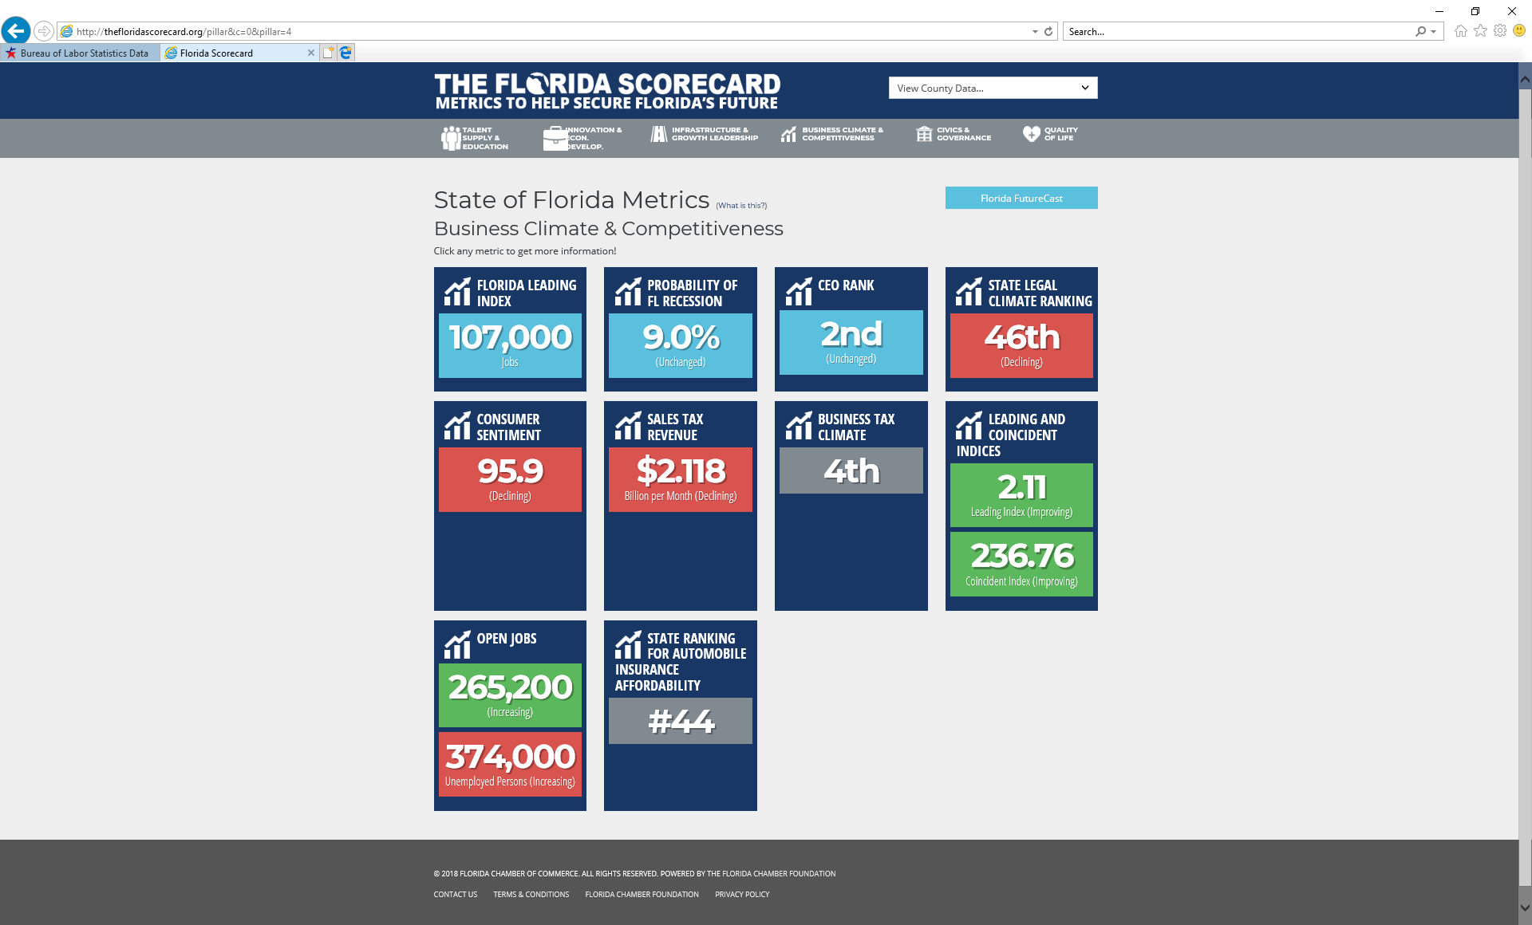
January 2018
Notes:
On Business Climate & Competitiveness

Slide 35
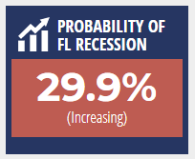
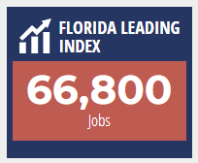
January 2018
July 2019
Notes:
On Business Climate & Competitiveness

Slide 36
Upcoming Events
Future of Florida Forum
October 28-29, 2019
Hyatt Regency Grand Cypress Orlando
www.FloridaChamber.com/events/

Slide 37
Jerry D. Parrish, Ph.D.
Chief Economist & Director of Research
jparrish@flfoundation.org
850.521.1283

