Slide 1
2019 Florida Trust Investment Seminar
SHORT FIXED INCOME INVESTING
August 23, 2019

Slide 2
SHORT MATURITY FIXED INCOME INVESTING
Considerations for Investment of Cash & Reserve Assets
Relevant time horizon
Risk Tolerance
Return expectations
Market & Economic Environment
Challenges
Influence of the Federal Reserve
Investment Opportunities & Portfolio Management Strategy
Notes:
REVERSE THESE TWO?

Slide 3
Considerations for Investment of Cash & Reserve Assets
Notes:
THIS IS NOT SHOWN ON PREVIOUS PAGE

Slide 4
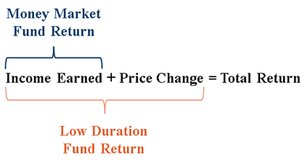
Investment of Cash and Reserve Assets
Bonds Provide Income and the Potential for Capital Gains
Key Considerations
For most investors, the chief appeal of bonds is the income return, measured by the yield
The search for yield should be balanced against the risks involved with holding bonds
The primary risks are deteriorating credit quality (or ultimately default) and higher market yields
Total return is a more complete measure of the return from bonds, reflecting both the income return and price appreciation/depreciation over the holding period
Notes:
Bonds provide income and the potential for capital gains.
For most investors, the chief appeal of bonds is the income return, measured by the
yield. The search for yield should be balanced against the risks involved with holding
bonds. The primary risks are deteriorating credit quality (or ultimately default) and
higher market yields. Total return is a more complete measure of the return from bonds,
reflecting both the income return and price appreciation/depreciation over the holding
period.
The performance among different sectors of the bond market can vary considerably.
Treasury securities usually do best when investors are seeking safety. Lower-quality
bonds generally outperform when investors expect the economy to improve. Returns on
low-quality bonds usually correlate better with returns on stocks than with Treasuries.

Slide 5
Investment of Cash and Reserve Assets
Bonds Provide Income and the Potential for Capital Gains
Key Considerations
The performance among different sectors of the bond market can vary considerably
Treasury securities usually do best when investors are seeking safety
Lower-quality bonds generally outperform when investors expect the economy to improve
Returns on low-quality bonds usually correlate better with returns on stocks than with Treasuries
Notes:
Bonds provide income and the potential for capital gains.
For most investors, the chief appeal of bonds is the income return, measured by the
yield. The search for yield should be balanced against the risks involved with holding
bonds. The primary risks are deteriorating credit quality (or ultimately default) and
higher market yields. Total return is a more complete measure of the return from bonds,
reflecting both the income return and price appreciation/depreciation over the holding
period.
The performance among different sectors of the bond market can vary considerably.
Treasury securities usually do best when investors are seeking safety. Lower-quality
bonds generally outperform when investors expect the economy to improve. Returns on
low-quality bonds usually correlate better with returns on stocks than with Treasuries.

Slide 6
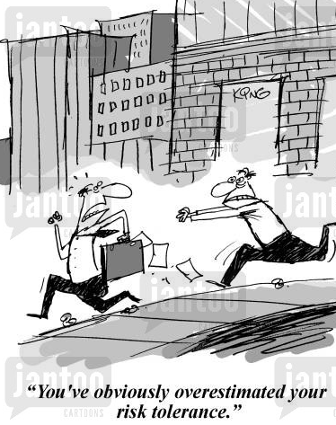
Risk Factors Inherent to Bonds
Interest rate risk
Yield curve risk
Reinvestment risk
Credit risk
Liquidity risk
Call and prepayment risk
Volatility risk
Inflation risk
Event risk
Sovereign risk

Slide 7
Investment of Cash and Reserve Assets
Bonds Provide Income and the Potential for Capital Gains
Investment Objectives in Order of Priority
SAFETY -Primary objective is the protection of capital
LIQUIDITY -Strategy to provide sufficient liquidity to meet cash flow requirements
INVESTMENT INCOME -Maximize income & total return per quality, safety, liquidity constraints
Why Consider Tiering of Operating Cash?
TIERING -helps optimize meeting of liquidity needs while maximizing investment return
MATCH -investment strategy and underlying maturities with cash flow requirements
OPERATING CASH -under 9 months
SHORT-TERM CASH RESERVES -9 months & longer
LONGER-TERM CASH RESERVES -24 months & longer
Conservative Investment Management
SELECT -conservative strategy consistent with Florida State Statutes
PARTNER -with experienced mangers having time tested risk management approach
PERFORMANCE -is more than returns, it includes liquidity in all market environments
Notes:
SPACING AFTER HYPHEN
AND IS THERE A WAY TO RE-WORD THE BULLETS TO FIT ON ONE LINE? IF YOU ARE PROJECTING THIS, LESS IS MORE. (AND IF YOU ARE PROJECTING, GRAPHICS CAN HELP YOU “BUILD” THE SLIDES)

Slide 8
Investment of Cash and Reserve Assets
Bonds Provide Income and the Potential for Capital Gains
Cash Strategies
Money market funds seek to preserve the value of your investment at $1.00 per share, but it is possible to lose money by investing in these types of funds
Understand characteristics of fund and its underlying holdings, key risk considerations
Credit quality, credit risk, diversification of positions
Liquidity of fund, liquidity risk of security types
Weighted average maturity
How much bank exposure? Concentration in one name? Security types such as ABCP (Asset Backed Commercial Paper) which can become illiquid during periods of market stress?
NAV falling below $1 has occurred due to credit problems, illiquid securities
Compare 7-day SEC yield across different funds
The 7-day yield = net income earned over a 7-day period / average units outstanding over the period / 7 times 365
Determine WHY some funds have a higher yield than others – often it is because more risk is being taken
Note that unlike other performance measures, the SEC yield does not include realized gains and losses from sales of securities.
Notes:
THIS IS A LOT OF WRITING TO PROJECT ON A SCREEN – AND I’D PROBABLY MOVE THE “SCARY” BREAKING THE BUCK COMMENT MUCH LOWER, IT’S GIVEN A LOT OF SHELF SPACE/EMPHASIS
Bonds provide income and the potential for capital gains.
For most investors, the chief appeal of bonds is the income return, measured by the
yield. The search for yield should be balanced against the risks involved with holding
bonds. The primary risks are deteriorating credit quality (or ultimately default) and
higher market yields. Total return is a more complete measure of the return from bonds,
reflecting both the income return and price appreciation/depreciation over the holding
period.
The performance among different sectors of the bond market can vary considerably.
Treasury securities usually do best when investors are seeking safety. Lower-quality
bonds generally outperform when investors expect the economy to improve. Returns on
low-quality bonds usually correlate better with returns on stocks than with Treasuries.

Slide 9
Investment of Cash and Reserve Assets
Bonds Provide Income and the Potential for Capital Gains
Enhanced Cash / Low Duration Strategies
Longer maturity profile offers higher return potential but introduces modest interest rate risk
Higher income return or running yield typically available compared to a money-market fund
Understand characteristics of fund, underlying holdings, key risk considerations
Maximum portfolio duration, maximum maturity allowed for each security
Average fund quality, minimum quality permitted for an individual security
Diversification requirements, by sector, name, security
Liquidity of fund and security types
Compare total return performance with benchmark
Consider risk adjusted return, volatility of returns
Notes:
TO FIT ON ONE LINE CHANGE TO: “Longer maturity profile offers higher return potential but introduces modest interest rate risk”
INCREASE SPACING BETWEEN BULLETS IF PROJECTED
Bonds provide income and the potential for capital gains.
For most investors, the chief appeal of bonds is the income return, measured by the
yield. The search for yield should be balanced against the risks involved with holding
bonds. The primary risks are deteriorating credit quality (or ultimately default) and
higher market yields. Total return is a more complete measure of the return from bonds,
reflecting both the income return and price appreciation/depreciation over the holding
period.
The performance among different sectors of the bond market can vary considerably.
Treasury securities usually do best when investors are seeking safety. Lower-quality
bonds generally outperform when investors expect the economy to improve. Returns on
low-quality bonds usually correlate better with returns on stocks than with Treasuries.

Slide 10
Comparison of Options for Short Maturity Investors
 |  | Regulated (Money Market) Funds
Considerations | Internal / Bank | “Prime” | Govt | Short Duration Fund / ETF
Daily cash | P | P | P | P
Mark-to-market |  | P |  | P
Subject to gates |  | P
Diversified portfolio |  | P | P | P
Large exposure to banks | P | P
Co-investing |  | P | P | P
Credit research team |  | P |  | P
Duration risk |  |  |  | P
Credit risk | P | P |  | P
Return optimization |  |  |  | P
Custom liquidity | P
Illiquidity | P
Custom guidelines | P
Fees | Low (not 0) | Low-modest | Low-modest | Modest
Notes:
I’D DELETE THE CDARS COLUMN, THEY HAVE NO IDEA WHAT THAT IS – MAYBE THE SEPARATE ACCOUNT COLUMN, TOO, AS THE TRUST WOULDN’T WANT THEM TO GO THAT ROUTE?

Slide 11
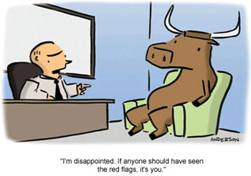
Risk & Diversification
An investment policy statement shall provide for appropriate diversification of the portfolio.
Investments held should be diversified to the extent practicable to control the risk of loss resulting from over concentration of assets in a specific maturity, issuer, instrument, dealer, fund or bank through which financial instruments are bought and sold.

Slide 12
Tiering of Short-Term Fixed Income Portfolios
Customized for relevant time horizon, return expectation and risk tolerance
Lower Expected Return
Less Volatility
Higher Expected Return
Higher Volatility
Florida Trust Day to Day Fund Florida Trust Short Term Bond Fund
(Straddles Enhanced Cash & Low Duration)
 | Tier 1 “Cash Management” | Tier 2 “Enhanced Cash” | Tier 3 “Low Duration 1-3yr” | Tier 4 “Low Duration 1-5yr”
Investments | Commercial Paper (CP) Certificates of Deposit (CDs) Governments/Agencies Corporates – IG Only | CP and CDs Governments/Agencies Asset-Backeds Corporates – IG Only | Governments/Agencies Asset-Backeds Mortgages Corporates – IG Only | Governments/Agencies Asset-Backeds Mortgages Corporates – IG
Average Quality | AA | AA | AA- | AA-
Average Portfolio Duration | 1-6 months | 6-18 months | 1.5-3.0 years | 1.5-3.0 years
Maturity Range | Overnight to 1 year | Overnight to 3 year | 1-5 years | 1-7 years
Expected Return over Money Markets | +25bps | +45bps | +60bps | +100bps
Notes:
JUST GO WITH CP AND CDs – ALSO SPREAD OUT THE TABLE MORE FOR PROJECTION

Slide 13
Short Fixed Income Investment Philosophy
Superior results are attained through active management
Identify market inefficiencies and mispriced sectors /securities offering superior risk-adjusted return.
Dynamic markets require dynamic account management.
Combination of both ‘top-down’ and ‘bottom-up’ approach
Top-down market macro view for duration and sector decisions that yield optimal risk-adjusted results.
Bottom-up security selection optimizes macro themes and opportunities to enhance performance.
Diversification is essential to managing portfolio risk
Cross-sector correlation analysis improves risk-adjusted performance across a range of market environments.
Broad opportunity set provides multiple sources of excess return.
Forward looking approach to credit analysis with a global industry focus
Extensive proprietary research along with strong dealer relationships.
Direct management contact provides qualitative opinion in addition to quantitative assessment.

Slide 14
Market Environment

Slide 15
We Detect the (Not So) Subtle Hint of a Rate Cut…

Slide 16
U.S. Bond Market Environment
U.S. Treasury Curve Remains Inverted Reflecting Expected Fed Cuts in 2019
Yields Moved Materially Lower Over the Quarter Led by the Belly
Tenor | 12/31/2018 | 6/30/2019 | Change
3-month | 2.36 | 2.09 | -0.27
1-year | 2.60 | 1.93 | -0.67
2-year | 2.49 | 1.76 | -0.73
3-year | 2.46 | 1.71 | -0.75
5-year | 2.51 | 1.77 | -0.74
10-year | 2.68 | 2.01 | -0.67
30-year | 3.02 | 2.53 | -0.49
Source: Bloomberg
Source: Bloomberg
Credit Spreads Recovered from Q4 Supporting Credit Allocations
And Lower Credit Quality Outperformed
Source: ICE BofAML 1-5y Indices
Source: ICE BofAML 1-5y Indices

Slide 17
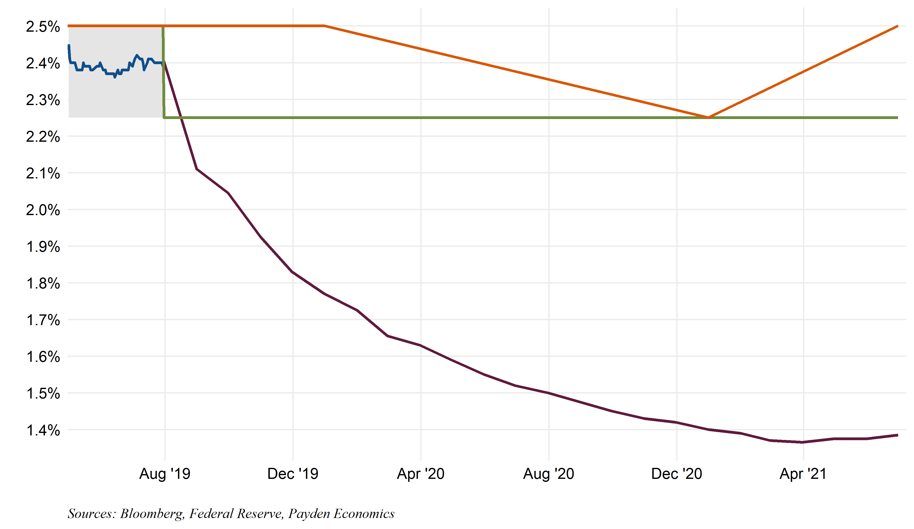
The Number of Rate Cuts Implied By Markets Seems Overdone
Path of the Federal Funds Rate (Payden versus FOMC versus “The Market”)
FOMC Median
Payden Forecast
Really?
Market Implied

Slide 18
Global Negative Interest Rates Cannot Be Ignored
Slowing global growth, easy global central bank policies have led to bonds with negative interest rates
There is almost $13 trillion of debt trading with negative yields in the world today.
2-year government bond yields are negative in 18 countries including Japan, Italy, and Germany.
Source: Bloomberg
Notes:
https://research.stlouisfed.org/publications/economic-synopses/2018/06/01/recession-signals-the-yield-curve-vs-unemployment-rate-troughs/

Slide 19
Front End Experienced Solid Total Returns Across Sectors
Total Returns
 | Q2 2019 Total Return | Trailing 1yr Return
3-month LIBOR | 0.70% | 2.60%
3-month T-bill | 0.64% | 2.31%
6-month T-bill | 0.72% | 2.51%
12-month T-bill | 0.94% | 2.98%
2 Yr. Treasury | 1.47% | 3.94%
3 Yr. Treasury | 1.96% | 5.09%
5 Yr. Treasury | 2.81% | 7.42%
10 Yr. Treasury | 4.23% | 10.38%
30 Yr. Treasury | 6.76% | 12.85%
Source: ICE BofAML Indices
Enhanced cash indexes
Low duration indexes (1-5 Year)
*Performance includes income that is exempt from federal income taxes
Source: ICE BofAML Index data as of June 30, 2019
Front-end securitized and corporate credit sector total returns have been strong over the trailing 12 months despite the heightened volatility in spreads, with T-bills generating total returns over 2%.
Notes:
CHART NEEDS TITLE SAYING THAT IT IS TOTAL RETURNS – I WOULD DELETE A COUPLE ROWS FROM THE TABLE TOO, MAYBE 6MO BILL AND 7 YEAR

Slide 20
Front-End Investment Grade Corporate Spreads Modestly Wider During Q2, 26bps Tighter YTD 2019
1-3 Yr. Corporate yields are below 3% for the first time since the beginning of 2018
 | 6/30/2019 | YTD Change | 2018 Change
Yield to Worst (%) | 2.46% | -0.98% | +1.04%
OAS (bps) | 67 | -26 | +41
Source: Payden & Rygel, ICE BofAML 1-3 Year U.S. Corporate Index as of June 30, 2019
Notes:
DEFINE IG?

Slide 21
Front End Credit Spreads Are Once Again Below Their 5-Year Average
For your credit opportunity set, risk premiums are back below their 5-year average as of March 2019 after finishing 2018 higher
While the Treasury yield curve is flat, credit curves for investment grade corporates have some steepness
Source: ICE BofAML 1-5 Year index data. Government OAS. Trailing 5 year data as of 6/30/2019
Source: Barclays Point Average OAS, Investment Grade Corporates June 30, 2019

Slide 22
Economic Environment

Slide 23
Our Economic Outlook In 5 Bullets
Is a recession likely in 2019? A key indicator says the risk over the next 12 months is “high,” other indicators suggest a downturn is not imminent.
We expect 2.4% GDP growth in 2019—slower growth than in 2018 but still above “trend.” The “trade war” shaved about 0.5% from our topline growth figure but the consumer remains resilient.
Job growth should still be strong enough to push the unemployment rate to 3.5% by the end of the year.
We expect inflation, as measured by core PCE, to pick up by year end.
The FOMC will stay on hold after the “insurance” rate cut. The number of rate cuts implied by markets over the next year seems overdone.

Slide 24
Low Layoffs Suggest A Tight Labor Market, Not A Recession
An increase in initial claims for unemployment insurance (a proxy for layoffs) would suggest the labor market is deteriorating. As of May, initial claims for unemployment are near record lows and below year ago levels--a stark contrast to prior periods when economic expansions were coming to an end..
Initial Claims for Unemployment Insurance (% Change Year-Over-Year) Prior To The Last Six Recessions Versus Today
*Average of the last six pre-recession periods
Source: Department of Labor, NBER, BCA Research, Payden Calculations

Slide 25
Leading Economic Indicators Suggest Slower Growth, Not A Recession
The Conference Board’s Leading Economic Index (LEI) aims to show turning points in the business cycle. Currently, the LEI is up 2.5% year-over-year, and has fallen as low as 0.3% year-over-year in June 2016. If there was a time to be concerned, it was then, not now.
Leading Economic Index Prior to the End of the Last Six Expansions Versus Today
TODAY: LEIs have slowed, but growth remains positive, suggesting we have more room to run
HISTORICALLY: LEIs usually turn negative long before recession begins
*Average of the last six recession periods
Source: Conference Board, NBER, BCA Research, Payden Calculations

Slide 26
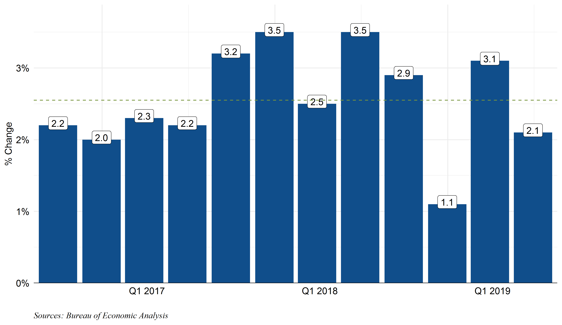
What Can We Expect From Economic Growth in 2019? Slower Than 2018 But ~2.4%
Real GDP - % Change Quarter-Over-Quarter Annualized
Q1 2019 GDP exceeded expectations despite the government shutdown
Average

Slide 27
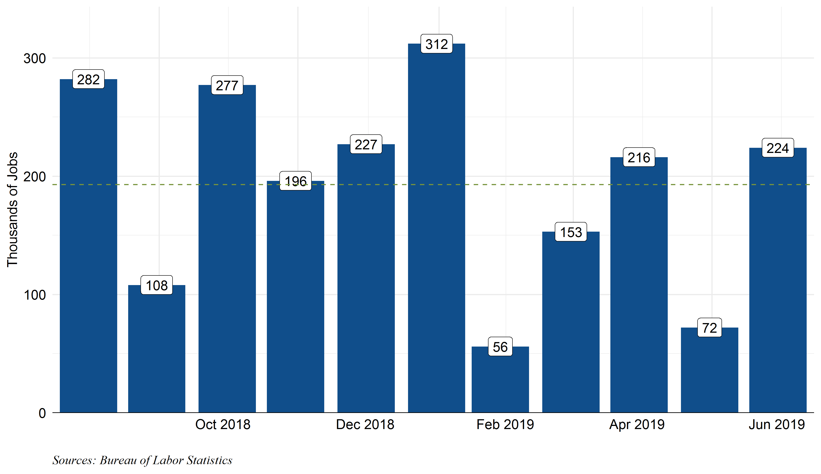
Job Growth Slower But Solid Considering We’re 10 Years Into Expansion
Monthly Nonfarm Payrolls – 000s of Net New Jobs
Don’t believe +224k or +72k. The three month moving average is 171,000
Average

Slide 28
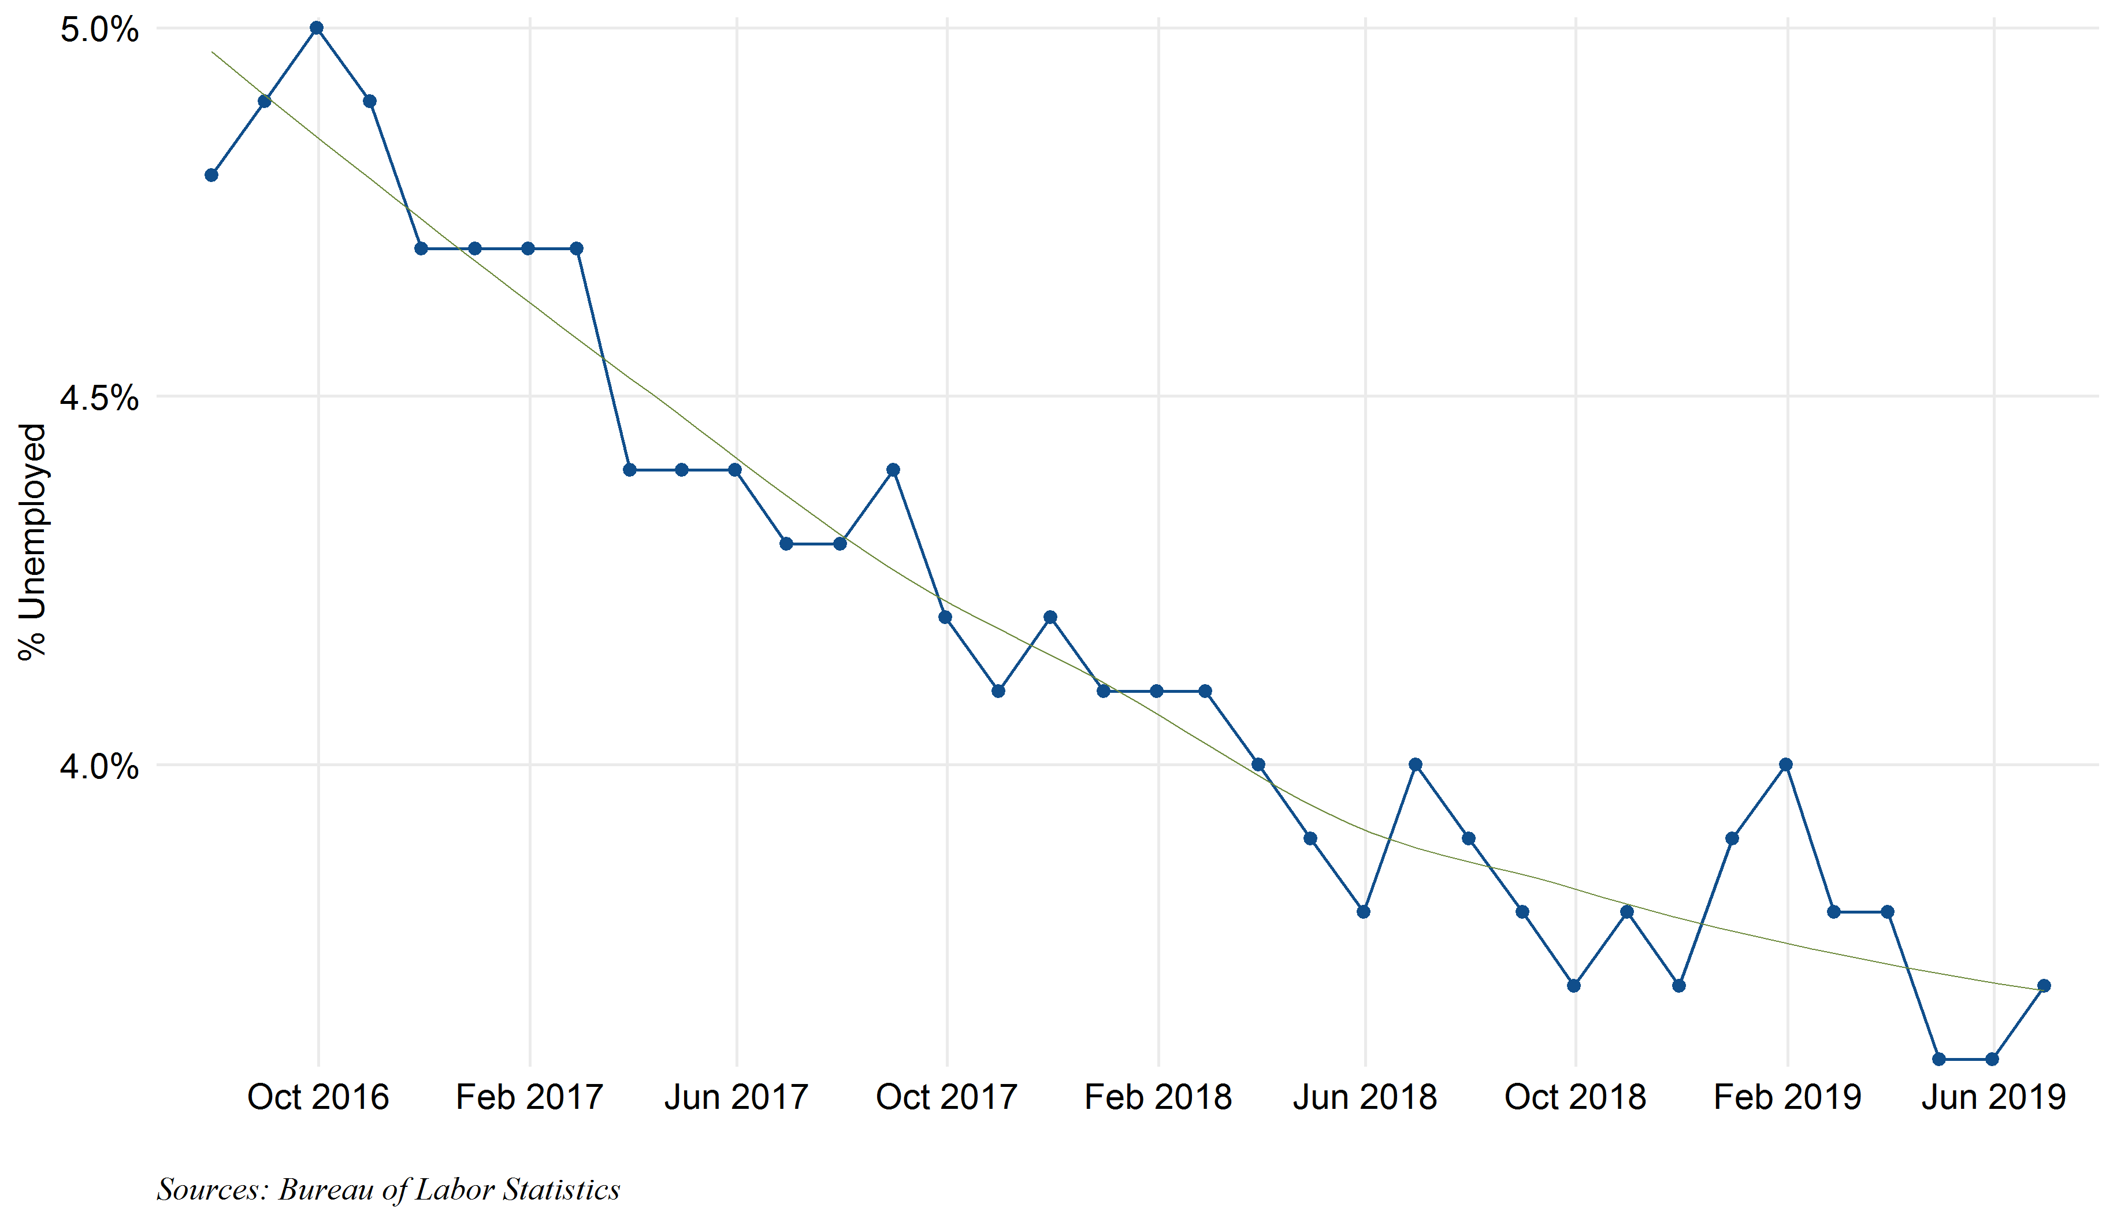
Unemployment Will Fall To 3.5% in 2019 Even With A Slower Pace Of Job Growth
U-3 Unemployment Rate
Trend*
Steady decline for many years
P&R 2019 Forecast
3.5%
*Best smoothed trend for non-linear relationships which strips out outliers

Slide 29
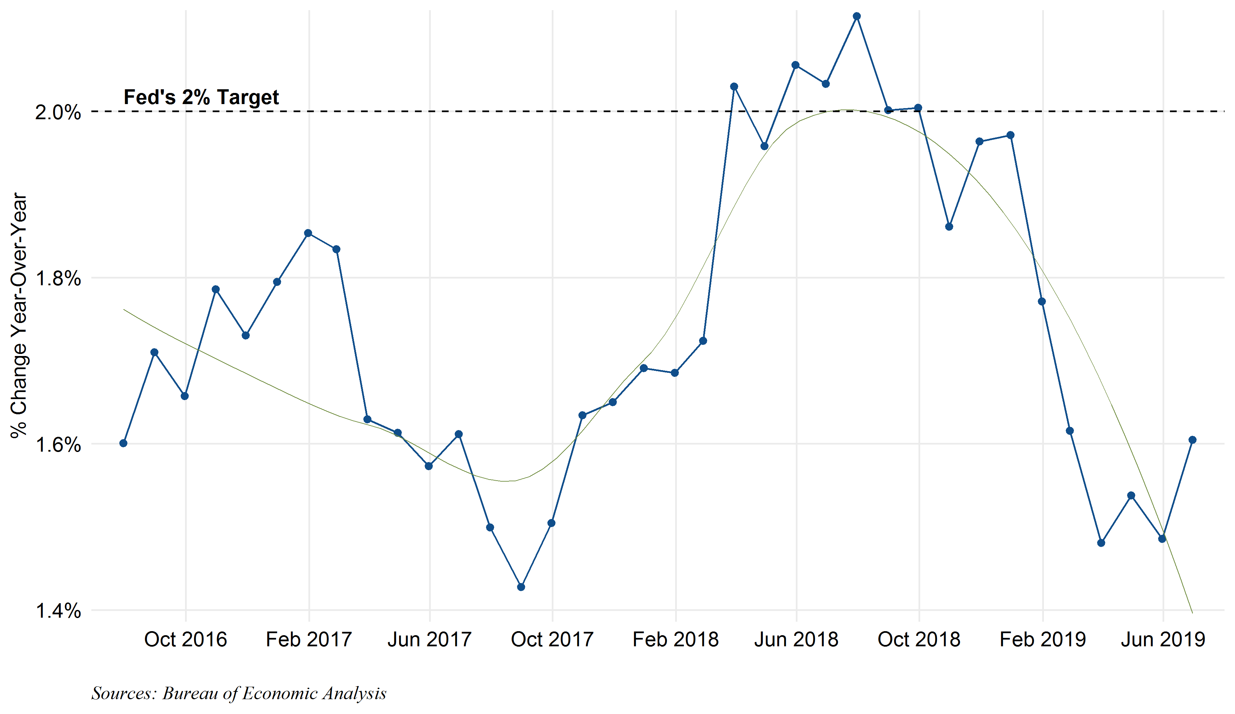
We Expect Inflation To Move Closer To 2% By The End Of 2019
Core PCE Inflation - % Change Year-Over-Year
Trend*
P&R 2019
Forecast
1.8%
“Transitory” drop
*Best smoothed trend for non-linear relationships which strips out outliers

Slide 30
Our 2019 Outlook Summary:
2019 U.S. Economic Forecasts –
Payden Economics Versus FOMC, Bloomberg Consensus and 2018 Actual
 | P&R Forecast | Median FOMC Forecast | Bloomberg Consensus Forecast | 2018 Actual
Economic Growth Q4/Q4 Real GDP % Change | 2.4% | 2.1% | 2.1% | 3.0%
Unemployment Rate Level At Year End | 3.5% | 3.6% | 3.7% | 3.9%
Inflation (Core PCE*) % Change Year-over-Year By Year End | 1.8% | 1.8% | 1.8% | 1.9%
Policy Rate (Fed Funds Rate) Upper Bound of Fed Funds Target Range | 2.25% | 2.50% | 1.70%** | 2.50%
Slower than 2018, but still right around trend
One and done
Sources: Bloomberg Consensus, Payden Estimates, Bureau of Labor Statistics and Bureau of Economic Analysis
*Core PCE is the personal consumption expenditures price index excluding food and energy
**Market implied rate at year end using fed fund futures

Slide 31
Investment Opportunities & Portfolio Management Strategy

Slide 32
Comparison: Money Market Fund and Short Bond Fund
Which Choice is Right for Your Investment?
$1.00 NAV MONEY MARKET FUND
Excellent investment solution for daily and very short term, frequent flow cash assets
Desirable Features:
Certainty of current income
Principal preservation
Less Desirable Features:
High reinvestment risk
Lower total return potential
SHORT BOND FUND
Excellent investment solution for reserve assets, not likely to be needed for 9 months or longer
Desirable Features:
Higher total return potential
Lower reinvestment risk
Liquidity readily available if unexpected need arises
Less Desirable Features:
Increased price variability / risk
Slightly more credit risk
REMEMBER: Bonds mature at par (assuming no default), erasing unrealized losses due to rise in market interest rates
Notes:
SHOULD YOU USE ACTUAL FUND NAMES?

Slide 33
Comparison: Income, Price and Total Return
Which Choice is Right for Your Investment?
$1.00 NAV MONEY MARKET FUND
Certainty of income at time of purchase
No unrealized loss at time of withdrawal if $1 NAV not “broken”
SHORT BOND FUND
Short bond fund a longer strategy offering greater income and total return potential
Short term unrealized losses possible during periods of rising interest rates
BUT bonds mature at par (assuming no default), erasing unrealized losses due to rise in market rates
A better choice for longer-term reserve assets given NAV variability
ICE BofAML U.S. Indices - 12 Month Period Ending 6/30/2019
12 Month Return Due To: | 3-Month Bill Index | 1-3 y Treasury Index | 1-3 Year AAA-A US Corp Index
Price Return | 0% | 1.74% | 1.77%
Income Return | 2.31%* | 2.23% | 3.07%
Total Return | 2.31% | 3.96% | 4.84%
*For discount instruments, income return is technically classified as price return for accounting purposes, but is known with certainty at time of purchase
Source: ICE BofAML
Notes:
“…Year Treasury…” – AGAIN SAME QUESTION ON FUND NAME

Slide 34
Perspective on Duration, Credit, and Return Volatility
Extending duration adds yield and return potential
Adding credit improves risk adjusted return profile, or Sharpe Ratio
Total Return (Monthly) 10 Years Ending 06/30/2019: | iMoneyNet Money Market Index | ICE BofAML 1-Year Treasury | ICE BofAML 1-3 Treasury | ICE BofAML 1-3 Govt/Crdt | ICEBofAML 1-5 Govt/Crdt | B.B. Aggregate
Yield-to-Maturity¹: | 2.10% | 1.95% | 1.81% | 2.01% | 2.04% | 2.49%
Duration¹: | - | 0.9 yrs | 1.8 yrs | 1.8 yrs | 2.6 yrs | 5.7 yrs
Maximum | 0.20% | 0.36% | 0.79% | 0.81% | 1.13% | 2.10%
Minimum | 0.00% | -0.16% | -0.79% | -0.62% | -1.00% | -2.37%
Average | 0.04% | 0.07% | 0.10% | 0.14% | 0.19% | 0.32%
Std Deviation (monthly)² | 0.20% | 0.31% | 0.83% | 0.83% | 1.43% | 2.89%
# of Negative Rolling 12 Months | 0 | 0 | 6 | 0 | 7 | 20
# of Negative Months | 0 | 21 | 39 | 36 | 38 | 40
# of Negative Months in % | 0% | 18% | 33% | 30% | 32% | 33%
Annualized Trailing Returns
3 Year | 1.29% | 1.46% | 1.29% | 1.61% | 1.75% | 2.31%
5 Year | 0.81% | 1.06% | 1.21% | 1.46% | 1.85% | 2.95%
10 Year | 0.43% | 0.78% | 1.20% | 1.63% | 2.31% | 3.90%
Sharpe Ratio (10 Year) | - | 1.02 | 0.89 | 1.41 | 1.30 | 1.19
The Sharpe ratio is the average return earned in excess of the risk-free rate per unit of volatility or total risk.
¹ As of 6/30/2019. ² Annualized .
Notes:
34
34
I WOULD FIND TWO ROWS AND AT LEAST ONE COLUMN TO DELETE

Slide 35
Market Yields
As of June 30, 2019
 | Tsy | Tsy FRN | Agency | Dealer Repo | Agency Floater | Supra (AAA) | CP (A-1) | LIBOR | Corp (A IND) | Corp (A FIN) | Corp FRN (IND) | Corp FRN (FIN) | Muni | ABS (Cards) | ABS (Auto)
1-day | 2.13 |  | 2.09 | 2.44
1-month | 2.09 |  | 2.12 |  |  |  | 2.37 | 2.40 |  |  |  |  | 1.24 | 2.48 | 2.48
3-month | 2.09 | 2.14 | 2.03 |  |  | 2.25 | 2.27 | 2.32 | 2.19 | 2.22 |  |  | 1.24 | 2.58 | 2.56
6-month | 2.10 |  | 1.91 |  | 2.19 | 2.18 | 2.12 | 2.21 | 2.20 | 2.24 |  |  | 1.24 | 2.51 | 2.49
12-month | 1.93 |  | 2.01 |  | 2.19 | 2.05 |  | 2.18 | 2.22 | 2.27 | 2.63 | 2.70 | 1.24 | 2.38 | 2.34
2-year | 1.76 | 2.21 | 1.85 |  | 2.23 | 1.90 |  |  | 2.25 | 2.31 | 2.79 | 2.91 | 1.25 | 2.16 | 2.16
3-year | 1.71 |  | 1.81 |  |  | 1.85 |  |  | 2.26 | 2.32 | 2.85 | 2.98 | 1.26 | 2.17 | 2.18
5-year | 1.77 |  | 1.88 |  |  | 1.89 |  |  | 2.41 | 2.47 | 3.01 | 3.14 | 1.31 | 2.34
Yields are Payden estimates and should not be relied upon for investment decision making
Notes:
FONT

Slide 36
Why Should Investors Consider a Short Bond Specialist?
An active approach to cash management can enhance performance without compromising liquidity and stability
Front-end Yield Curve Technicals
Flexible use of yield curve opportunities
Pull-to-par characteristics of short maturity investments
Active management captures mispricing
Additional Security Types
Floating-rate securities used to manage interest rate duration
Use of structured products like AAA-rated consumer ABS as a corporate bond diversifier
New Issue Marketplace
Consistent participation captures selling concession
Opportunities for reverse-inquiry issuance
Segmented Investor Base
Money market funds and non-traditional investors have different motivations for what they buy
You benefit from other investor’s restrictions (i.e. buying securities just past other buyers limitations)
Liquidity
Relative value analysis factors in liquidity: less liquid ≡ more compensation
Front-end specialization leads to better broker relationships

Slide 37
Florida Trust Day to Day Fund
As of June 30, 2019
Government Focused - Daily Liquidity – Stable NAV - Fitch Rating and Oversight
Investment Objective: This $1 NAV money market fund provides investors with liquidity, stable share price and as high a level of current income as is consistent with preservation of principal and liquidity.
Portfolio Characteristics: Average fund maturity will not exceed 60 days. Investments are focused on US Government securities (US Treasuries, agencies and repurchase agreements) as well as short-term corporates and commercial paper.
Portfolio Characteristics
Portfolio Market Value | $763.8 million
Fitch Rating | AAA mmf
Days to Maturity | 28 days
SEC 7 Day Yield (net) | 2.43%
Portfolio Returns
Since YTD Trailing Trailing Trailing Inception
2019 1 Year 3 Years 5 Years (1/13/09)
Day to Day Total Return (gross) 1.32% 2.51% 1.63% 1.10% 0.67%
Day to Day Total Return (net) 1.26% 2.39% 1.53% 0.99% 0.56%
ICE BofAML 3 Month Treasury Bill 1.24% 2.31% 1.38% 0.87% 0.47%
Periods over one year annualized.
Sector Allocation (% of Portfolio Assets)
Maturity Distribution (% of Portfolio Assets)
38% Govt/Govt Gntd
22% Floating Rate
Notes:
DAY TO DAY OR DAY-TO-DAY?

Slide 38
Florida Trust Day to Day Fund: Yield Comparison and Performance Summary
Attractive Relative Yield and Strong Total Return
Day to Day Fund Net 7-Day SEC Yield, Since Inception vs. Crane Money Fund Average Yield*
Jerome Powell named Fed Chair (11-17)
First round of SEC Reforms target 2a-7 Money Market Fund guidelines(01-10)
Fed announces “Operation Twist” - extends avg maturity of Fed portfolio (09-11)
Fed announces QE3, $40B MBS purchases/mo and low rates through 2015 (09-12)
The Fed raises rates 25 basis points, ending seven years of zero interest rate policy
(12-15)
New 2a-7 Money Market Fund rules take effect (10-16)
Quantitative Easing (“QE1”) Ends
(03-10)
SEC New
2a-7 Money Market Fund rules announced
(07-14 )
QE2 Announced, Fed to purchase $600B of Tsys (11-10)
Fed extends Operation Twist (06-12)
Fed announces Taper of $10 billion per month (12-13)
The Fed raises rates
Interest rates
(12-15 – 12-18)
*Institutional (government) 7-day yields
Notes:
NOT SURE ALL THE BOXES WILL PROJECT WELL

Slide 39
Florida Trust Short Term Bond Fund
As of June 30, 2019
Investment Objective: Appropriate for investors seeking high average credit quality and potential for returns greater than cash alternatives, with some fluctuations in net asset value (NAV). Maintains safety of principal and maximizes available yield, balancing quality and diversification.
The Short-Term Bond Fund invests in securities with effective maturities of less than five years. The weighted average maturity of the portfolio is 2.0 years. Securities are all high quality, primarily AAA and AA-rated.
Portfolio Characteristics
Portfolio Market Value | $863.5 million
Fitch Rating | AAA mmf
Duration | 1.82 yrs
SEC 30 Day Yield (net) | 2.07%
Portfolio Returns
YTD Trailing Trailing Trailing Since Inc.
2019 1 Year 3 Years 5 Years (1/1/92)
Short Term Bond Fund (gross) 2.74% 4.27% 1.88% 1.59% 3.82%
Short Term Bond Fund (NAV) 2.60% 3.99% 1.62% 1.33% 3.49%
Benchmark* 2.44% 3.96% 1.29% 1.21% 3.37%
*ICE BofAML1-3 Year Treasury Index 2/2000 to present; Money Market Index prior. Periods over one year annualized.
Sector Allocation (% of Portfolio Assets)
Duration Distribution (% of Portfolio Assets)

Slide 40
Florida Trust Short Term Bond Fund
Longer-Term Strategies Outperform Cash Over Time
Short Term Bond Fund NAV vs. 2-Year Treasury Yield
1994: overheating economy, inflation increasing
Short-Term Bond Fund NAV (LHS)
2-Year Treasury Yield (RHS)
2000-2001: Y2K concerns, tech bubble, Fed hikes rates
2004-2006: Housing market bubble
Short Term Bond Fund NAV
2008 :
Liquidity Crisis
and bailouts
1998: Global Crisis
- Russian Default
- LTCM Collapse
2015- 2018
Fed interest rate normalization
Treasury Yield (%)
2008-2013:
Quantitative Easing
1, 2, and 3
2001: WTC Attacks
Recession/ Collapse of Enron
Change in 2-Year Treasury Yield from 12/31/18: -74 basis points

Slide 41
Biographies
Elizabeth M. Westvold, CFA® Senior Vice President
2011 – Joined Payden & Rygel
Lisa A. Redding
Vice President
2010 – Joined Payden & Rygel
Elizabeth M. Westvold, CFA, is a Senior Vice President at Payden & Rygel. Based in the Boston office, Beth serves as a Senior Client Portfolio Manager for U.S. institutional clients including public plans, corporations, universities and endowments and insurance companies.
Prior to joining Payden & Rygel, Beth was a managing director in BlackRock’s global client group for seven years, responsible for developing and maintaining relationships with institutional clients. Prior to 2005, she was a managing director and fixed income portfolio manager with State Street Research & Management Co. and earlier worked in fixed income strategies for Harvard Management Company.
A member of the CFA Boston Society, Beth holds the Chartered Financial Analyst designation. Beth is president and an investment committee member of the Trustees of Donations to the Episcopal Church. She earned an MBA from the Tuck School of Business at Dartmouth College and a BA, cum laude, in economics and biology from Middlebury College.
Lisa Redding is a Vice President at Payden & Rygel. Based in the firm’s Boston office, she works with portfolio managers to implement investment policy and strategy needs of institutional clients.
Prior to joining Payden & Rygel, Lisa was Research Coordinator at hedge fund Kaintuck Capital Management. She held various roles over seven years within research and trading, and headed the firm’s marketing efforts. Prior to that Lisa worked within Ernst & Young LLP’s tax practice, both domestically and abroad.
Lisa Redding holds the FINRA series 6 and 63 licenses. She earned a BS in Business Administration from American University in Washington, D.C. with concentrations in Finance and International Economics.

