Slide 1
Leadership – Cultivating Decision-Making Strategies
Florida Local Government Investment Trust Annual Seminar
August 23, 2019
R. Max Lohman, Esq.
City Attorney
City of Palm Beach Gardens
Town Attorney
Town of Lantana

Slide 3
What is Decision- Making?

Slide 4
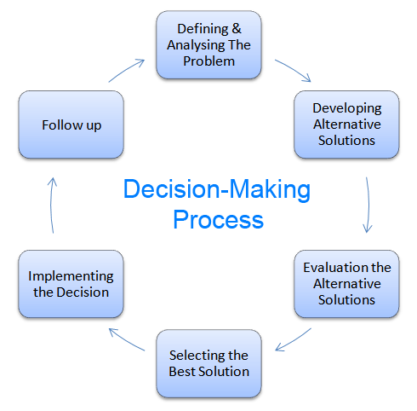

Slide 5
Types of Decisions
Programmed decision routine, almost automatic process, recurs with some frequency
Rules or guidelines are available
Managers have made decision many times
Nonprogrammed decision unstructured and occurs much less often than a programmed decision
There are no rules or guidance to follow
Unusual situations that have not often been addressed
Decision made based on information, intuition and judgement

Slide 6
Programmed Decisions
Basic operating systems, procedures and standard organizational transactions
McDonald’s employees are trained to make the Big Mac according to specific procedures.
Starbucks uses programmed decisions to purchase coffee beans, cups and napkins.

Slide 7
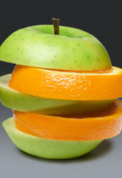
Nonprogrammed Decisions
Involve strategy and organization design, most often made by senior leaders
Decisions about new facilities
Technology solutions
Labor contracts
Legal issues
Managers must treat each one as unique, investing large amounts of time, energy and resources into exploring the situation from all angles.
Intuition and experience are major factors in these decisions.

Slide 8
Why Evaluate Our Decision-Making Effectiveness?
Organizational Effectiveness Depends Upon
Effective decision making
Recognizing bad decisions
Quickly responding to less than optimal decisions
Decision making
most basic and fundamental managerial activity
closely linked with the Planning function
component of Organizing, Leading and Performance Improvement

Slide 9
Timely Decision-Making
Strategic Planning
Project Planning
Timelines
Deadlines
Opportunity Cost
Time Value
Incremental Cost

Slide 10
Considerations in Delegation of Decision-Making Authority
Individual
Strengths
Weaknesses
Preferences
Group
Diversity
Group Think
Empowerment
Engagement

Slide 11
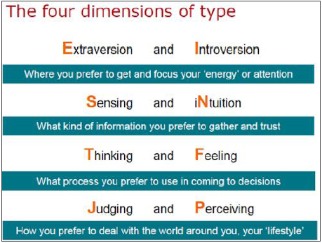
Myers-Briggs Personality Attributes

Slide 12
Myers-Briggs Attribute for Decision- Making
Thinking (T)
Facts
Logic
Objective
Analytical
Conflict Accepted
Feeling (F)
Feelings
Sensitive to Needs of Others
Seeks Consensus
Uncomfortable with Conflict

Slide 13
I OPT Assessment Tool
Reactive Stimulator
Action Oriented
Values Direct Communication
Likes Immediate Results
Likes Variety and Change
Inattentive to Detail
Logical Processor
Good Listener
Skeptical
Practical
Task Oriented
Disciplined
Hypothetical Analyzer
Relational Innovator
Critical Thinker
Focus on Facts
Analytical
Big Picture Focus
Problem Solver
Detects Relationships
Innovator
Change Generator
Flexible
Adaptive

Slide 14
Decision-Making Strategy
Participatory
Consensus
Intuitive
Analytic
Reason
Democratic
Autocratic
Command

Slide 16
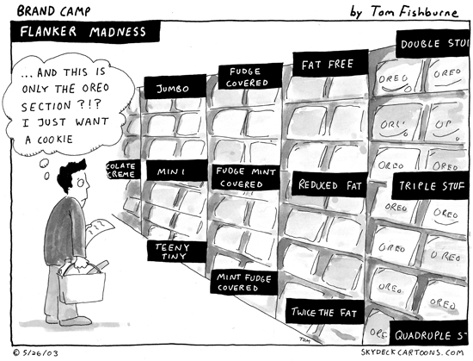

Slide 17
Decision-Making Environment
Certainty
Risk
Uncertainty

Slide 18
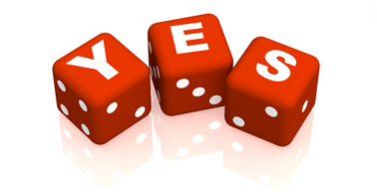
Certainty
Reasonable certainty of alternatives and conditions associated with each alternative
Few organizational decisions made under these conditions
Rare in a complex environment

Slide 19
Risk
Probability estimate applied to alternatives and potential payoffs or costs
Based on past experiences, relevant information, advice of experts and judgment
Decision based on which alternative has the highest probability of working effectively

Slide 20
Uncertainty
Alternatives, risks, consequences unknown
Most decision making in organizations
Secure as much relevant information as possible
Approach with logic and reason
Intuition, judgment and experience will play major role

Slide 21
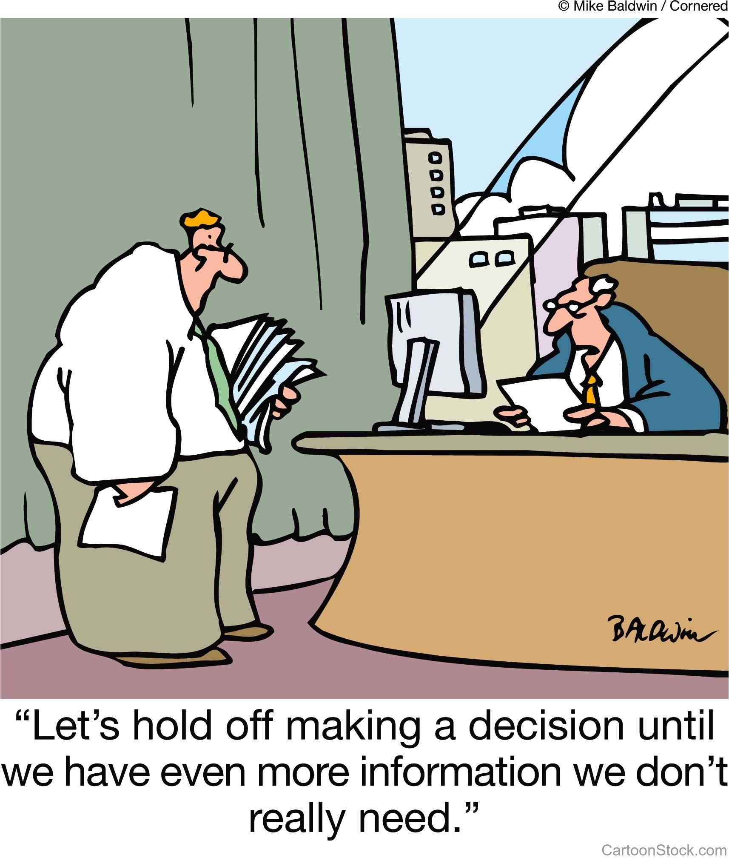

Slide 22
Decision-Making Tools
Cost/Benefit Analysis
SWOT Analysis/OODA Loop
Peer Comparison
Industry Practices
Feasibility Study
Market Research
Brainstorming

Slide 23
Leadership - Cultivating Decision-Making Strategies
R. Max Lohman, Esq.
max@lohmanlawgroup.com

