Slide 1
Paul Jones
Cyber Security
What You Don’t Know
Will Hurt You
CIO City Of West Palm Beach

Slide 2
Presentation Roadmap
Not SO Long ago
Social
Engineering
The
Dark Side
.
The Security
Landscape
.
A
Brief History
.
Must
Haves
Reducing
Liability

Slide 3
Objectives
Provide an overview of the current security landscape
Define challenges from the perspective of the organization and IT
Take a look at the dark side
Define security awareness / social engineering
Review ways to reduce liability
Discuss security must haves and best practices

Slide 4
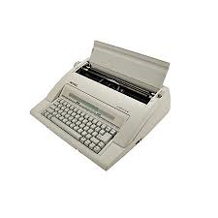
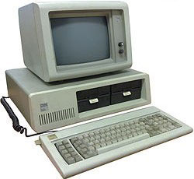
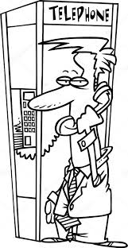
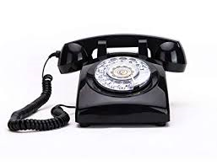
Not so Long Ago
Not SO Long ago

Slide 5
The Security Challenge
Organization
IT
State Initiatives
Fiscal Responsibilities
Politics
Legal Concerns
Budgets
Finance
Processes
Asset Management
Audits
Citizens
Day-to-Day Ops
Innovation
Project Mgmt.
Maintenance
Installations
Life Cycle Mgmt.
Communications
Customer Service
Testing
Business Analysis
Security
Security

Slide 6
The Balancing Act
Ease-of-Use
Maintenance
Speed to Delivery
Cost Cutting
Simplicity
Get-It-Done
Security
Projects
Quality
Availability
Functionality
Customer Service

Slide 7
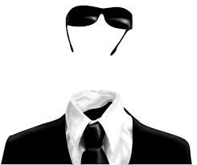
Unbalanced
VISIBLE ISSUES
INVISIBLE SUCCESSES

Slide 8
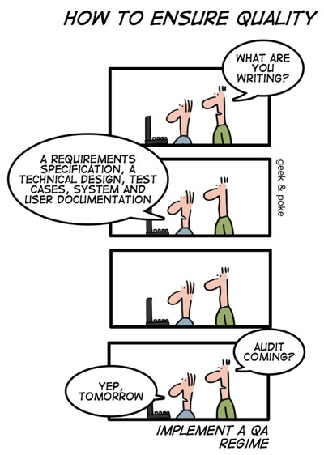
Is IT Funny?

Slide 9
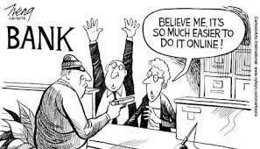
Who are the Bad Guys
Hackers
Hacktivists
Insiders
Vendors
Pranksters
Organized crime
Competitors
Thrill seekers
Revenge seekers
Anybody/Anywhere

Slide 10
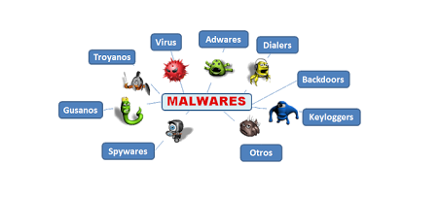
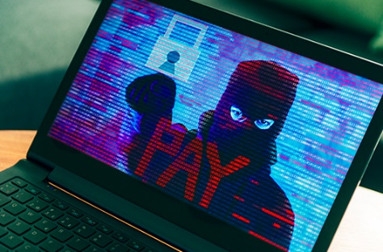
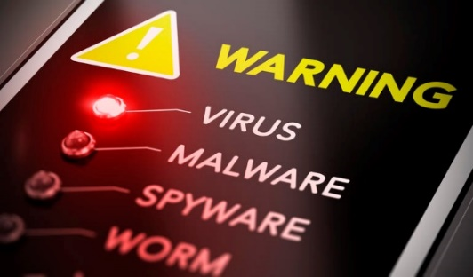
Attacks
Malware / Viruses
Breaches
Leakage
Insider Threats
Bots/Botnets
Denial of Service
Vendor
Mistakes
Ransomware
Social Engineering

Slide 11
Information Value & Cost
Record Type | Estimated Underground Value per record (McAfee and World Privacy Forum)
Financial Account | $14.00–$25.00
Credit/Debit Card | $4.00–$5.00
Medical Account Data | $0.03–$2.42
Full Medical Record with supporting documents | $50.00
Record Type | Estimated Breach Cost Per Record (Ponemon Institute 2016 Report)
Health | $355.00
Education | $246.00
Financial | $221.00

Slide 12
The Dark Side

Slide 13
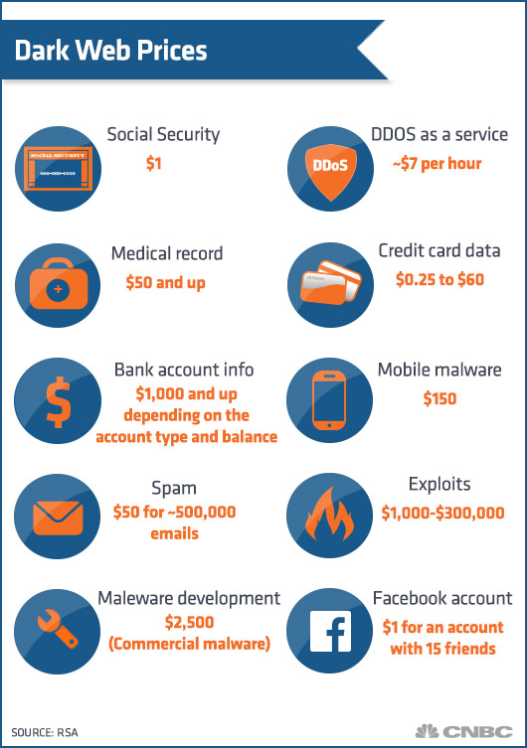
Shopping Made Easy

Slide 14
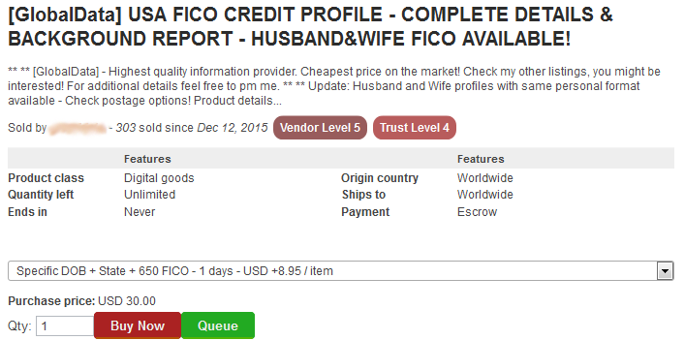
Shopping Made Easy

Slide 15
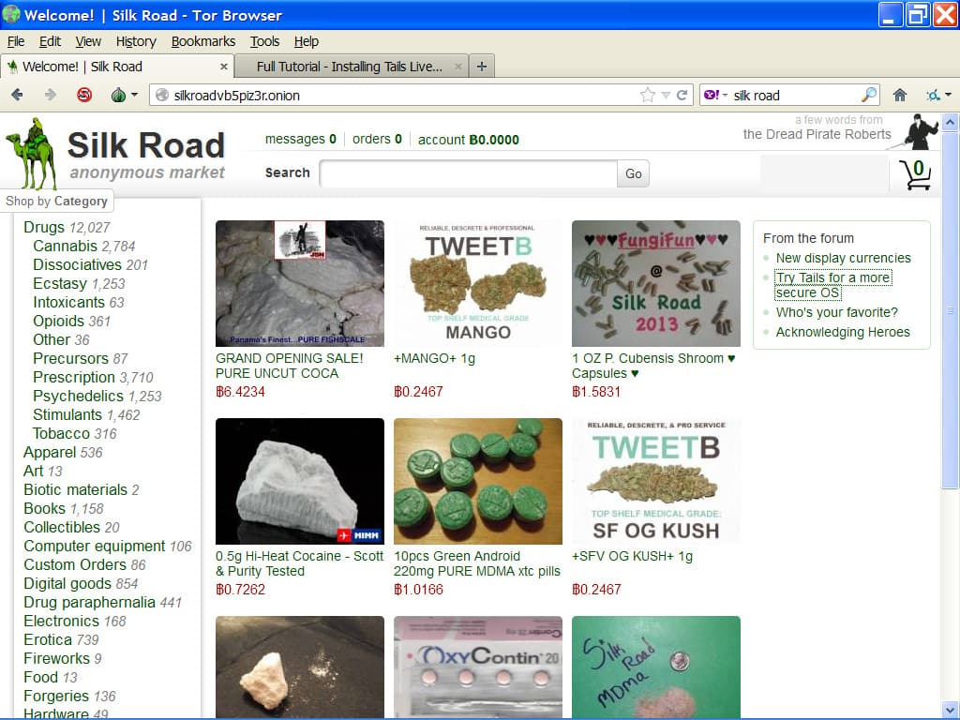
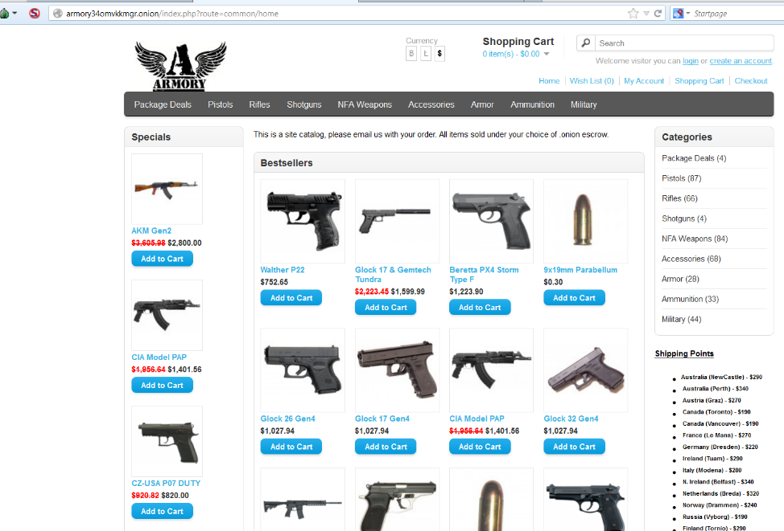
Shopping Made Easy

Slide 16
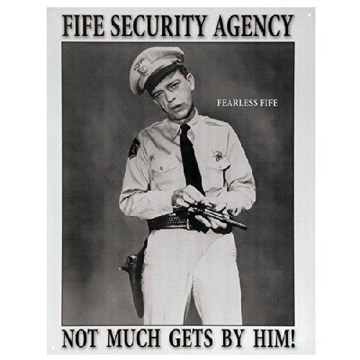
One to Many

Slide 17
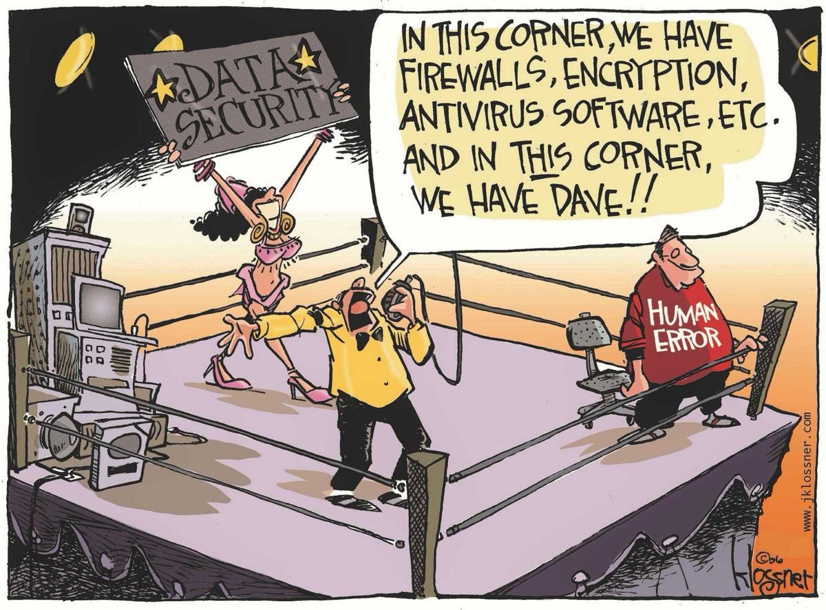
Misconception – “Security is an IT thing”
A new study reveals the more than 8 out of 10 (88%) companies surveyed admit their organization experienced a significant security event in the last twelve months with as many a 73% of the companies indicating that the cause was insiders” (The Norris Corporation)
Internal Disclosures
Disgruntled employee
Social engineering scams
Phishing scams
Human errors
Human naivety

Slide 18
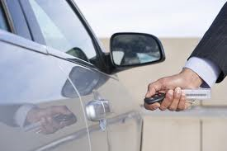
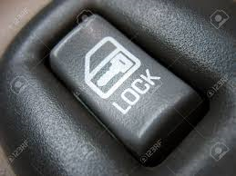
Security Awareness
Security awareness is the knowledge and attitude that members of an organization possess regarding the protection of the physical, and especially informational, assets of that organization.

Slide 19
An Easy Target
Weak passwords
Not changing passwords
Writing passwords down
Opening any and everything
Being gullible to scams
Ignoring good security policies and practices
Thinking IT has it all taken care of
NOT BEING AWARE

Slide 20
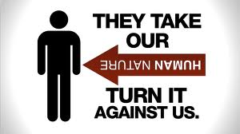
Social Engineering
“You could spend a fortune purchasing technology and services…and your network infrastructure could still remain vulnerable to old-fashion manipulation.”
-Kevin Mitnick

Slide 21
Social Engineering
Pretexting – Creating a fake scenario
Phishing – Send out bait to fool victims into giving away their information
Fake Websites – Molded to look like the real thing. Login with real credentials that are now compromised
Fake Pop-up – Pops up in front of real website to obtain user credentials
Deepfakes – Fake audio and video that makes a person appear to be saying something the did not say

Slide 22
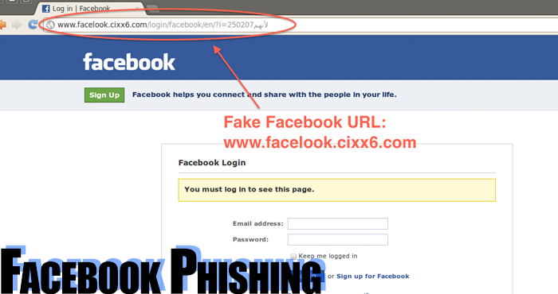
Social Engineering
“They sounded so legitimate“
Hello John, this is Bill from IT (Microsoft) and I am updating your computer right now – but I need your password to install these new much-improved applications for you. You are going to love these new features!!!

Slide 23
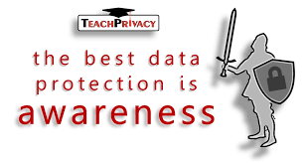
A Culture of Awareness
Annual security awareness training
Monthly security tips
Send social engineering examples
Send alerts and attack notifications
Test users by going phishing
Establish peer groups
The “See it Say it” Program
Do reward and recognition

Slide 24
Reducing Liability
Due Diligence is the act of continually investigating and understanding the risks and vulnerabilities the organization faces.
Due Care is implementing security policies, procedures, standards, and countermeasures to provide protection from those threats.
“If an organization does not practice due care and due diligence pertaining to the security of its assets, it can be legally charged with negligence and held accountable for any ramifications of that negligence” (Harris, 2010, p. 110)
CYO
Cover Your Organization

Slide 25
The Three Tiers
Balanced Security
Strategy
Plans
Policies
Processes
Procedures
Standards
Guidelines
Oversite
Due Diligence
Due Care
Audits
Awareness
Documentation
Response
Administrative
Compliance
Governance
Technical
Physical
Technical Considerations and Infrastructure

Slide 26
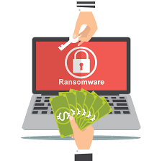
It is not a Matter of IF It is a Matter of When!!!!!
$600,000
Riviera Beach
$470,000
Tallahassee
$460,000
The
Wheel
of
Misfortune
Lake City
$17,000,000
Atlanta
$30,000
Key Biscayne
$18,000,000
$400,000
Baltimore
Jackson County GA

Slide 27
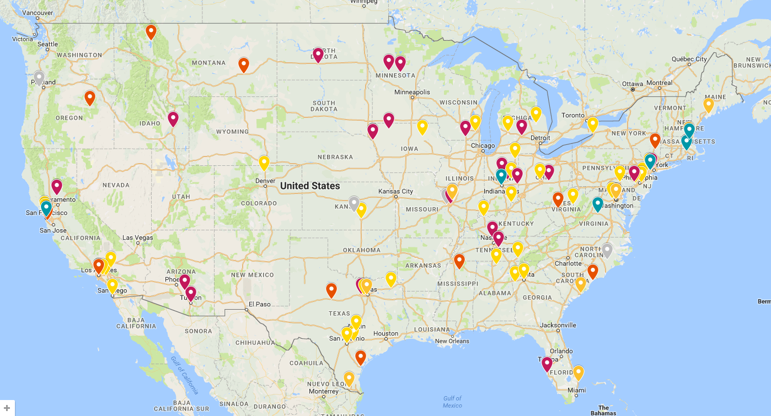
Ransomware Breaches

Slide 28
Organization Must Haves
Establish strong senior leadership buy-in (make security important)
Develop robust governance (what you permit, you promote)
Communicate and educate at all levels
Create a culture of security awareness
Incorporate security in change management
Integrate all three tiers (Technical, Administrative, Compliance)
Trust but verify (external audits)
Be prepared (incident response plan)
Demand continual action and improvement
Reward and recognize

Slide 29
It’s about Risk Mitigation
If we only have so much time and resources, where and how we focus our efforts is the key!!
Identity
Risk
Assess
Risk
Risk Management Process
Risk Management Process
Review
Controls
Control
Risk

Slide 30
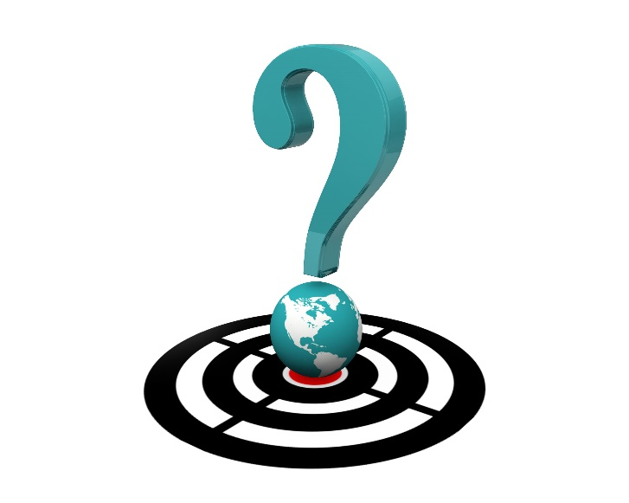
Questions?

