Slide 1


ARE YOU COMBATTING FRAUD AND CYBERSECURITY THREATS?
DATE: August 23, 2019
PRESENTED BY
NAME: Brian S. Orth
TITLE: Senior Vice President – Government Banking
SunTrust Bank, Member FDIC. ©2019 SunTrust Banks, Inc. SUNTRUST and the SunTrust logo are trademarks of SunTrust Banks, Inc. All rights reserved.
1

Slide 2
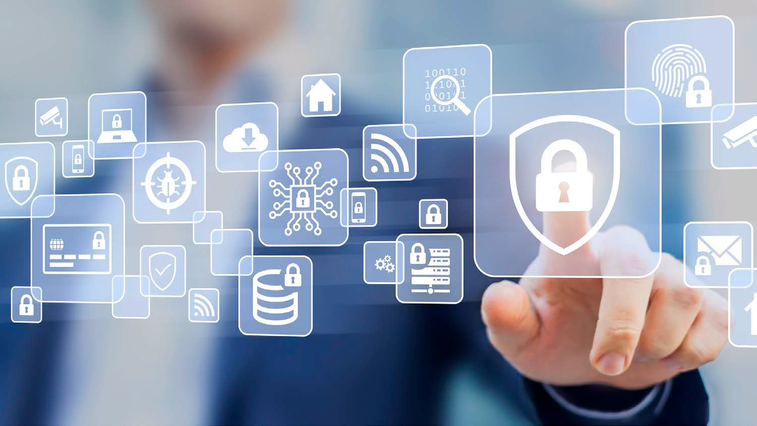


ARE YOU PREPARED TO COMBAT FRAUD?
DATE: August 23, 2019
PRESENTED BY
NAME: Brian S. Orth
TITLE: Senior Vice President, Government Banking
SunTrust Bank, Member FDIC. ©2019 SunTrust Banks, Inc. SUNTRUST and the SunTrust logo are trademarks of SunTrust Banks, Inc. All rights reserved.

Slide 3



F R AU D S TATI STI C S L AN D SC AP E
W H A T D O W E K N O W A B O U T
T H E C O S T O F F RA U D ?
Globally, fraud costs an estimated
Gross Domestic Product (GDP)
Building 6,200
$4.063
trillion annually
=
=
combined
SOURCE: “The Financial Cost of Fraud 2018” Crowe, Clark, and Whitehill
3

Slide 4




F R AU D S TATI STI C S L AN D SC AP E
W H A T D O W E K N O W A B O U T T H E
C O S T
O F F RA U D ?
IN 2018, SMALL BUSINESSES LOST ALMOST TWICE AS MUCH PER SCHEME TO FRAUD
$200,000
MEDIAN LOSS
$104,000
MEDIAN LOSS
> 100 EMPLOYEES
< 100 EMPLOYEES
SOURCE: “2018 Report to Nations” Association of Certified Fraud Examiners

Slide 5
F R AU D S TATI STI C S L AN D SC AP E
W H A T D O W E K N O W A B O U T
T H E C O S T O F F RA U D ?
every dollar of fraud,
This includes the lost value of the transaction, plus fees and interest incurred during applications/underwriting/processing stages, labor costs for fraud investigation, fines and legal fees, as well as external recovery expenses
In 2018, for
financial
services companies
incur $2.92 in costs,
up from $2.67 in 2017,
and representing
a
9.3% year-over-year increase.
SOURCE: 2018 Trust Cost of Fraud, LexisNexis Risk Solutions

Slide 6
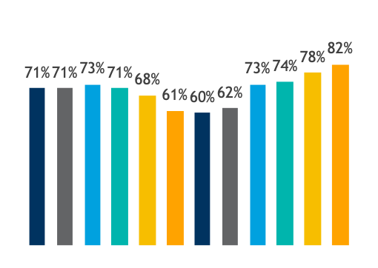







F R AU D S TATI STI C S L AN D SC AP E
P A YM ENTS FR A U D C O NTI NU ES TO R I S E
_{70%} Checks
Percent of Organizations that Experienced Attempted and/or Actual Payments Fraud 2007-2018^{[1]}
_{45%} Wire
Transfers
33% Debits
ACH
29%
Commercial Credit Cards
20%
ACH
Credits
Payment Methods that were Targets of Attempted/Actual Payments Fraud in 2018^{[1]}
(Percent of Organizations)
2007
2008
2009
2010
2011
2012
2013
2014
2015
2016
2017
2018
^{[1]}AFP Payments Fraud and Control Survey 2019

Slide 7











B ES T P R AC T I C ES TO MI T I GAT E PAY MEN T F R AU D
P A YM ENT FR A U D
P R EV ENTI O N M EA S U R ES
Q U ES TI O NS TO C O NS I D ER
When did you last review your payments risk and policies?
> Segregation of Accounts
> Daily reconciliations and other internal processes
Are you reviewing your accounts daily?
> Reconciling accounts daily to identify and return unauthorized ACH debits
Do you have ACH debit blocks in place?
> Block all ACH debits except on a single account set up with ACH debit filter/ACH positive pay
Positive Pay
Daily Reconciliations/ Other Internal Processes
Segregation of Accounts
Payee Positive Pay
2019 AFP Payments Fraud and Control Survey

Slide 8
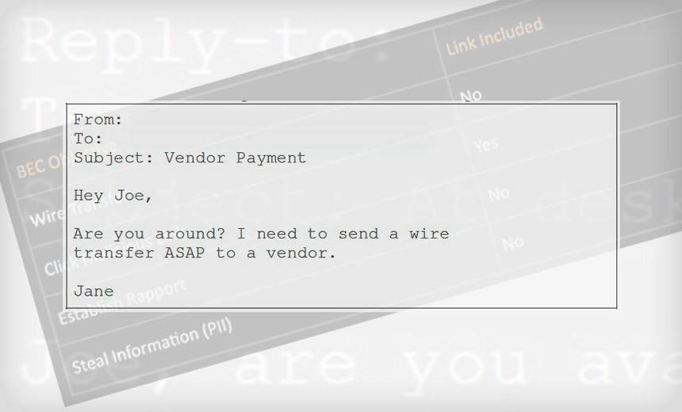
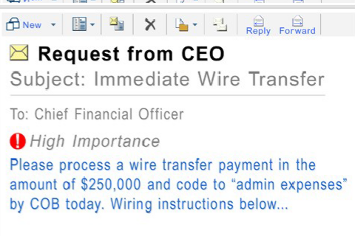
B U S I N ES S EMAI L C O MP R O MI S E ( B EC )
B U SI N E SS E MA IL C O MP R O MIS E
F RA U D
C O N T I N U E S
T O RI S E
80%
AFP Survey Respondents that experienced some form of Business Email Compromise in 2018
Sources: AFP Payments Fraud and Control Survey 2019, Internet Crime Complaint Center (www.ic3.gov)

Slide 9


B U S I N ES S EMAI L C O MP R O MI S E ( B EC )
I M PA C T S O F B U S I NES S EM A I L C O M P R O M I S E
F RA U D
B U S I N E S S E M A I L C O M P R O M I S E
Business Executive Fraud
Bogus Supplier invoices
Attorney Impersonation
T R E N D S
B U S I N E S S
E M A I L
C O M P R O M I S E
B Y T H E N U M B E R S
43%
Wire Transfers
20%
Checks
Title Company Hacks
Data Theft & W-2s, ACH, Direct Deposit
$12.5B+
lost between Oct 2013 and May 2018
200%
increased rate of incident
Sources: AFP Payments Fraud and Control Survey 2019, Internet Crime Complaint Center (www.ic3.gov)

Slide 10
B U S I N ES S EMAI L C O MP R O MI S E ( B EC )
TI P S FO R S TA YI NG A H EA D O F FR A U D
Examine your organization’s social media presence and make sure you are not sharing information that a fraudster might find handy (such as when executives may be out of the office); encourage employees to do the same with their personal profiles.
Consider whether universal out-of-office messages are necessary, especially at the executive level. If someone knows you’re away from the office, they might determine it’s the right time to strike.
Verbally confirm any emailed request for payment and set up dual approval to make sure at least two company employees are involved and aware when payments are being made.
Require complex passwords for all of your employees, change passwords regularly and do not share them or write them down.
Monitor your business credit report regularly to make sure
no unauthorized accounts are being established. Also review your bank account activity frequently- daily, if possible.
Conduct financial transactions on a dedicated computer that’s not being used on a day-today basis for email and other programs.
Make sure any banking statements are encrypted and delivered electronically, as it is too easy for mail to be compromised.
Have a well-communicated plan in place in the event that a security breach was to take place.

Slide 11
B U S I N ES S EMAI L C O MP R O MI S E ( B EC )
B ES T P R AC T I C ES TO P R EV EN T W I R E F R AU D
WIRE
VENDOR
Educate your staff about the fraud risks inherent in their daily processes. Training, training and more training!
Create a culture that empowers employees to ask questions
Develop processes for wire validation that include access to key executives for approval
Require two people to approve the movement of large sums or to make changes to any information that impacts the movement of funds (establish a verbal passcode)
Verify important or large transactions through an alternate method
Limit the amount of information available to the general public about your organizations internal operations
Conduct all banking on a dedicated machine used for no other task
Train associates on all vendor management policies
Empower employees to ask questions when in doubt
Know your vendor
Plan how your vendor will connect to you
Validate changes to Vendor Master File
Understand the vendors cybersecurity policies
Require verbal confirmations
Vendor list should be kept in a hard copy file
New vendor system flags
FOLLOW YOUR OWN PROCEDURES!

Slide 12



F R AU D I N T H E W O R KP L AC E
TH E FR A U D TR I A NG L E
Designed to explain the reasoning behind a worker's decision to commit workplace fraud. The three stages, categorized by the effect on the individual, can be summarized as motivation, opportunity and rationalization.
MOTIVATION
Can be either personal financial pressure or workplace debt problems
MOTIVATION
RATIONALIZATION
Ability to justify the crime in a way that is acceptable to their moral compass
OPPORTUNITY
The means by which the individual will defraud the organization
RATIONALIZATION
OPPORTUNITY
THE MOST IMPORTANT MITIGATION STRATEGY - EFFECTIVE CONTROLS
Source: Association of Certified Fraud Examiners (AFCE)
12

Slide 13

“M a n y o rga n i z a ti o n s d o n ’ t tra i n m a n a ge rs o r e m p l o y e e s to
u n d e rs ta n d w h y ru l e s a re p u t i n p l a c e . S o m e ti m e s e m p l o y e e s
w i l l o v e rri d e p o l i c i e s a n d p ro c e d u re s th a t w e re p u t i n p l a c e f or a re a s o n th a t th e y d o n ’ t u n d e rs ta n d . ”
David Sawyer, Certified Fraud Examiner Managing Director, Sawyer & Company
Source: Fraud Protection Strategies, SunTrust
13

Slide 14
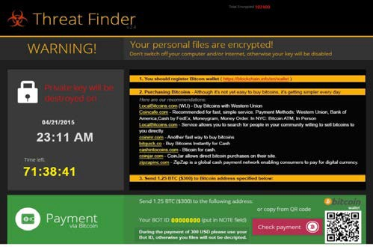
R AN S O MWAR E
W H A T I S I T ?
Ransomware is a type of malicious software (malware) that encrypts data on computer network systems and holds it hostage in exchange for money.
Ransomware is installed much like any other malware. In most cases, victims will receive an email with an attachment that looks genuine, but that actually contains the malicious ransomware code.
Once the infection is present, the malware begins encrypting files and folders on local drives, any attached drives, and potentially other computers on the same network.
Ransomware typically relies on unpatched vulnerabilities on the end user’s machine.
WHAT CAN HAPPEN?
Your data and systems can be encrypted and held hostage, stopping your business process and eliminating your electronic records.
WHAT CAN YOU DO TO PREVENT IT?
Your business controls are your best protection against ransomware. By establishing strong controls and being vigilant, you have the ability to safeguard your data.

Slide 15





R AN SOMWAR E S TATI STI C S
7.3 days
Average number of days a ransomware incident lasts
Payment Success Rate
$64,645
Average cost of ransomware incident related downtime
Source: ZDNet – “Ransomware: The cost of rescuing your files is going up as Attackers get more sophisticated”

Slide 16
R AN SOMWAR E S TATI STI C S
C O MMO N I N D U S T R I E S TA R G ETED B Y
RA N S O M W A RE
FI R S T H A L F 2 0 1 9
Media 2.6%
Consumer Goods 6.0%
Automobile 4.3%
Food & Staples 2.6%
Professional Services 22.4%
Materials 6.0%
Transportation 6.0%
Retailing 5.2%
Software Services 17.2%
Capital Goods 9.5%
Health Care 10.3%
Financial Services 34.0%
Source: Coveware's Ransomware Marketplace Report

Slide 17
R AN S O MWAR E B ES T P R AC T I C ES
B U S I N E S S P RO C E S S C O N T RO L S
Establish a process to regularly back up all critical systems and data, including regularly verifying the integrity of the backups. Backups should not be connected to any network longer than necessary to perform the backup. It is critical to segregate the copies from the original networks to prevent any compromise from affecting the backup.
Employ good network practices, including, but not limited to, keeping your software patches up to date, and restricting entry points into your network. Ransomware typically exploits vulnerabilities left in software that has not had the appropriate patches applied.
Deploy anti-virus and anti-malware solutions and ensure that they are set to automatically update and execute regular scans.
Restrict access where possible. Limit users to only the access they require to perform business functions and minimize the number of users with administrator accounts. In cases where users only need to read information, do not give them write or update access.
Prevent your users from running executables or macros from files transmitted over email.
Implement software restriction policies or other controls to prevent programs from executing from common ransomware locations (e.g., temporary folders supporting popular internet browsers, compression/decompression programs).
Train your employees to be aware of ransomware and how they can be tricked into installing it. Make sure employees are aware of their critical role in protecting your organization’s data.
Don’t open attachments in unsolicited e-mails, even if they come from people in your contact list, and never click on a URL contained in an unsolicited e-mail, even if you think it looks safe. Instead, close the e-mail and go to the organization’s website directly.

Slide 18
R AN S O MWAR E B ES T P R AC T I C ES
I F I T H A P P ENS , W H A T C A N YO U D O ?
Contact your local FBI office. Your local FBI field office can provide guidance on how to deal with the ransomware. You can find contact information for your local field office at www.fbi.gov/contact-us/field. Do not pay the ransom. Paying the ransom does not guarantee the return of your data or prevent the criminals from escalating their demands. It only serves to embolden criminals and fund their future activities.
Isolate the infected systems. If the infection has not spread to your entire network, take steps to segregate and protect the rest of your network.
Research the ransomware variant. Some, but not all, types of ransomware can be defeated without paying the ransom. If the variant can be identified and has a working mitigation, your data may be recoverable.
File a complaint with the Internet Crime Complaint Center (IC3) at www.ic3.gov. The IC3 will route your case to the appropriate local law enforcement bureau. It is at the discretion of that bureau as to whether to move forward on your case.
Review your business processes to identify the gap that allowed the malicious software to be executed. Once you find the gap, close it and provide training to your staff.
REMEMBER: PAYING THE CRIMINALS BEHIND RANSOMWARE DOES NOT GUARANTEE THE RETURN OF YOUR DATA.

Slide 19
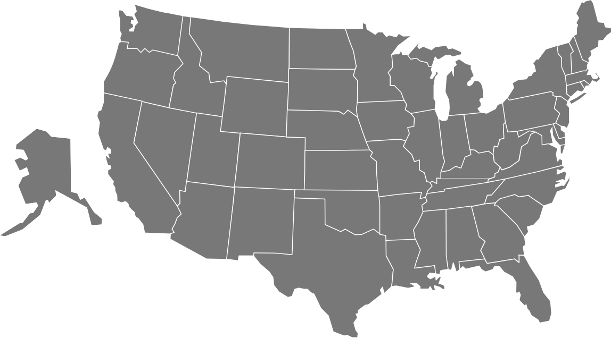
R AN S O MWAR E
T A R G E T E D A T T A C K S
O N S TA TE A ND L O C A L
G O V ER NM ENTS A R E
B EC O M I NG M O R E
FR EQ U ENT
S T A T E S T H A T E X P E R I E N C E D R A N S O M W A R E A T T A C K S I N 2 0 1 8
Source: Early Findings: Review of State and Local Government Ransomware Attacks, Recorded Future

Slide 20
R AN S O MWAR E
T A R G E T E D A T T A C K S O N SM A L L
B U SI N E SS E S A R E B EC O M I NG M O R E FR EQ U ENT
$116,000
average ransom demand
71%
of Ransomware Attacks Targeted Small Businesses in 2018
30%
20%
of victims had to cease operations immediately
of business victims lost revenue
Sources: Beazley Breach Briefing 2019, Beazley Breach Response Services; The Global Impact of Ransomware, Malwarebytes Labs

Slide 21

O U R B R EAC H ED D ATA I S EXP O S ED !
2019
Amazon
TicketFly
MyFitnessPal
Orbitz
150,000,000
Careem
Facebook 50,000,000
Chinese Resume Leak 202,000,000
T-Mobile
Facebook
Ticketmaster
Texas Voter Records
Grindr
Twitter 330,000,000
Tumblr
2018
Dixons Carphone
Marriott Hotels 383,000,000
Saks/ Lord & Taylor
Dell
Nametests 120,000,000
Bell
British Airways
Fling
Instagram
Viacom
CMS
Slack
2017
Equifax 143,000,000
Mozilla
Uber 57,000,000
Wendy’s
Friend Finder Network 412,000,000
LinkedIn 117,000,000
Nival
Securus Technologies 70,000,000
Anthem 80,000,000
MySpace 164,000,000
2016
CEX
Clinton Campaign
Dropbox 68,700,000
Lynda.com
uTorrent
Deep Root Analytics 198,000,000
Adult Friend
CarPhone Warehouse
Minecraft
VK 100,000,000
Fi
nder
AshleyMadison.com
Banner Health
Experian/ T-Mobile
2015
IRS
Tumblr
ClixSense
Yahoo 3,000,000,000
British Airways
Carefirst
European Central Bank
AOL
Target
MSpy
Imgur
Source: Information is Beautiful Data Breaches Visualization; databreaches.net; IDTheftCentre and media reports

Slide 22
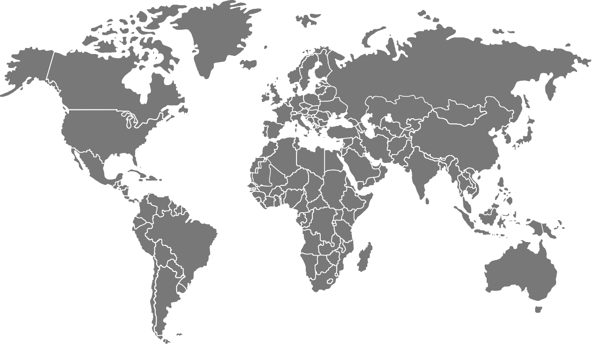



C Y B ER S EC URI T Y RI S KS
TH R EA TS TO FI NA NC I A L
S ER V I C E S
O R G A NI Z A TI O NS C O NTI NU ES TO EV O L V E
NATION STATES:
Theft
Espionage
Disruption
Regime Security
CAPABILITIES:
DDoS
Phishing
Malware (ATM Jackpotting, Data Wiping, etc.)
Third Party Compromise
Global Network
RUSSIA
NORTH KOREA
CHINA
ASSETS AT RISK:
Networks
Critical Systems (ATMs, SWIFT)
Intellectual Property
End Points
IRAN
CÔTE D'IVOIRE (IVORY COAST)
CRIME SYNDICATES:
Theft
CAPABILITIES:
Business Email Compromise
Social Engineering
NIGERIA
SOURCE: IBM Think 2019, How Financial Services Companies Should Respond to Cyber Security Attacks

Slide 23










THR EATS F R OM S TATE- SP ON SOR ED OR GAN I Z ATI ON S
Legal and
regulatory environment
Non-traditional collectors
Intelligence services
Joint ventures
Comprehensive National Power
Talent recruitment programs
Innovation Driven Economic Growth Model
Research partnerships
Front companies
Military Modernization
Academic Collaborations
M&A
S&T Investments
Source: 2018 Foreign Espionage in Cyberspace, National Counterintelligence and Security Center

Slide 24
P R OTE C TI N G Y OU R OR GAN I Z ATI ON
T I P S F O R M I T I G A T I N G C Y B E R R I S K
According to a National Center for the Middle Market survey, 55 percent of mid-market companies lack either an up-to-date cyber risk strategy or any defined cyber risk strategy at all.
1 | Focus on cyber resiliency. Attacks will happen when you least expect it.
2 | Know your ‘Crown Jewels’. Be realistic when assessing risk in a priority- driven way. Tighten security controls in a systematic way to protect assets that matter most to you – and those with the greatest appeal for attackers.
5 | Measure Effectiveness. Built risk and control performance measures to 1) drive meaningful action and 2) assess return on investment
6 | Make security everyone’s responsibility. Employee education is one the best investments in protection. Focus on demonstrations of how easy it is to fall prey to common phishing strategies.
3 | Apply a business lens. Craft a strategic and tactical response that goes beyond a technology solution, understanding the client, corporate, and regulatory ramifications.
4 | Have a plan. An incidence response playbook and protocols are guides to managing a crisis on a consistent and coordinated basis.
Know when to contact ecosystem partners and law enforcement.
7
Source: IBM Think 2019, How Financial Services Companies Should Respond to Cyber Security Attacks
24

Slide 25




B EST P R AC TI C ES I N P ER SON AL SEC U R I TY
Sign up for a free service called USPS Informed Delivery to digitally preview your mail and manage your packages scheduled to arrive. For more information on how to enroll, visit https://informeddelivery.usps.com/
“Winter is here!” — A credit report freeze is free in every U.S. state for you and your dependents Call your mobile provider to set up a Personal Identification Number (PIN) to mitigate SIM-Swapping
Utilize a VPN (Virtual Private Network) for business & personal use, especially if using public Wi-Fi networks Check https://haveibeenpwned.com/ and change your user IDs and passwords

Slide 26
QUESTIONS & ANSWERS

Slide 27
D I SC L OSU R E
The views and opinions expressed in this presentation are those of the speakers, and do not necessarily reflect the views or opinions of SunTrust Banks, Inc.
Reproduction, manipulation, adjustment or transmission, either in part or in whole, is prohibited without prior written permission from SunTrust Banks, Inc. Third party trademarks contained herein are property of their respective owners.
SunTrust Bank, Member FDIC. ©2019 SunTrust Banks, Inc. SUNTRUST and the SunTrust logo are trademarks of SunTrust Banks, Inc. All rights reserved.

