Slide 1
What’s New in Securities Regulation
and the Industry
Florida Local Government Investment Trust Seminar
August 22, 2019

Slide 2
OFR - Who Are We?
Florida Office of Financial Regulation (OFR)
Oversees Florida’s financial services industry
Created in 2003
Previously, Department of Banking and Finance
Financial Services Commission
Members: Governor, Attorney General, Chief Financial Officer, Commissioner of Agriculture

Slide 3
Mission
To protect the citizens of Florida, promote a safe and sound financial marketplace, and contribute to the growth of Florida’s economy with smart, efficient and effective regulation of the financial services industry.

Slide 4
Division of Consumer Finance
Licenses and regulates non-depository financial services industries and individuals
Mortgage Loan Brokers, Originators and Services
Retail Installment Sellers
Collection Agencies
Money Services Businesses
Consumer Finance Companies
Title Loan Companies
Total Licensees: 110,244

Slide 5
Division of Financial Institutions
Licenses and conducts periodic risk-based examinations and ensures state-chartered financial institutions meet state and federal requirements for safety and soundness
Banks
Credit Unions
International Bank Offices
Trust Offices
Registered Family Trusts
Total State Chartered Institutions: 194

Slide 6
Division of Securities
Regulates the sale of securities in, to or from Florida to ensure compliance with state and federal law
Dealers
Investment Advisers
Stockbrokers
Securities
Crowdfunding intermediaries
Total Licensees: 345,300

Slide 7
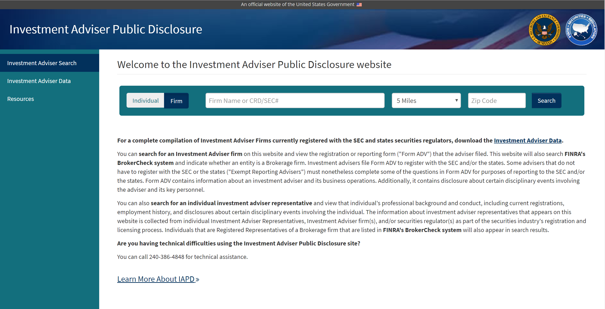
Investment Adviser Public Disclosure (IAPD)
https://www.adviserinfo.sec.gov/IAPD/Default.aspx

Slide 8
IAPD

Slide 9
IAPD

Slide 10
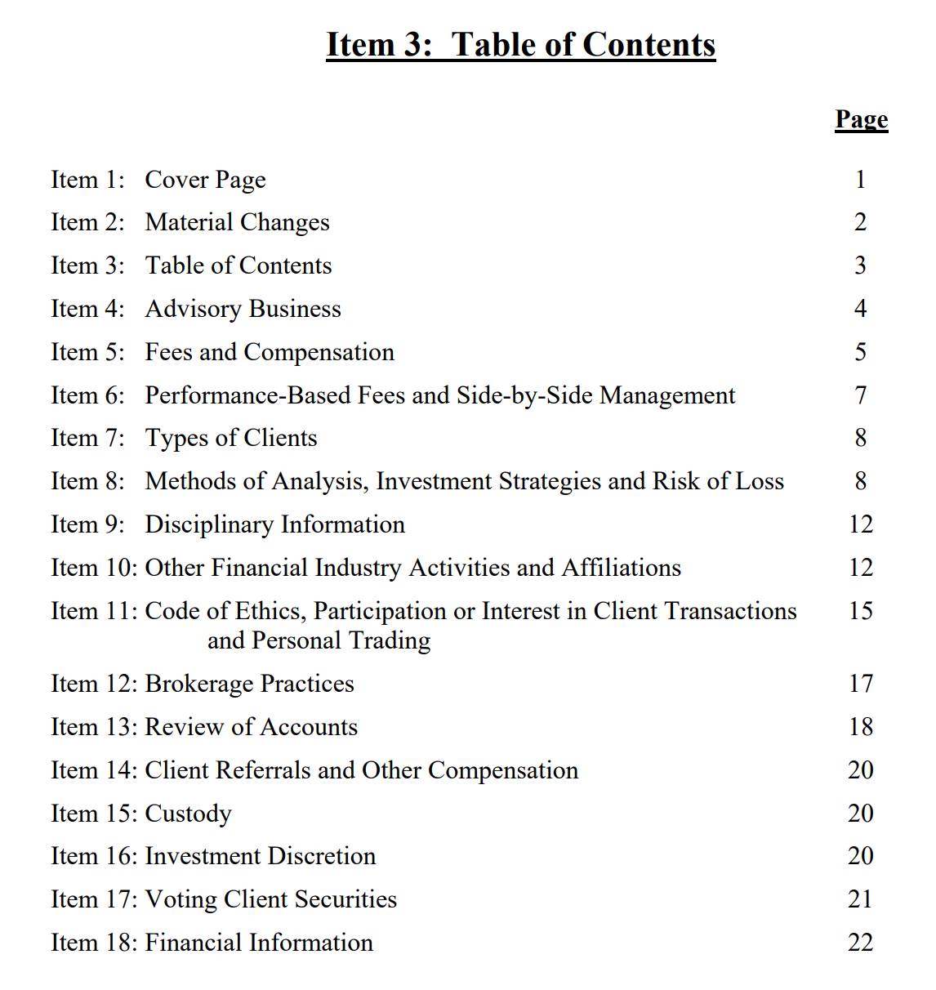
IAPD

Slide 11
Regulation Best Interest (Reg BI)
Imposes a new standard of conduct for broker dealers
Disclosure Obligation: Material facts must be disclosed about the relationship and recommendations
Capacity in which the broker is acting
Fees
Type and scope of services provided
Conflicts
Limitations on services and products

Slide 12
Regulation Best Interest (Reg BI)
Care Obligation: A broker-dealer must exercise reasonable diligence, care and skill when making a recommendation to a retail customer.
Understand potential risks, rewards, and costs associated with the recommendation
Consider these factors in light of the retail customer’s investment profile
Ensure a recommendation is in the retail customer’s best interest

Slide 13
Regulation Best Interest (Reg BI)
Conflict of Interest Obligation: The broker-dealer must establish, maintain, and enforce written policies and procedures reasonably designed to identify and, at a minimum, disclose or eliminate conflicts of interest.
Mitigate conflicts that create an incentive for the firm’s financial professionals to place their interest or the interests of the firm ahead of the retail customer’s interest;
Prevent material limitations on offerings, such as a limited product menu or offering only proprietary products

Slide 14
Regulation Best Interest (Reg BI)
Eliminate sales contests, sales quotas, bonuses, and non-cash compensation based on the sale of specific securities or specific types of securities within a limited period of time.
Compliance Obligation: Broker-dealers must establish, maintain and enforce policies and procedures reasonably designed to achieve compliance with Regulation Best Interest as a whole.

Slide 15
Cryptocurrencies
Digital assets created by companies or individuals that take the form of a virtual coin or token.
Intangible and exist only on the internet
Central banks and other governmental authorities do not insure or control cryptocurrencies
Trade on unregulated, opaque exchanges
Crypto-investment products
Initial Coin Offerings (ICOs) or Initial Token Offerings (ITOs)
Issuers sell coins or tokens to fund a particular project
Many are unregistered and operate outside regulatory requirements

Slide 16
Cryptocurrencies
Common Schemes
Fake Digital Wallets
Lure users into providing their key to open wallet
Scammer uses key to steal cryptocurrency
Pump and Dump
Groups buy thinly-traded cryptocurrency, hype it on social media to push up demand and price, then sell in consolidated sale
Price plummets and unsuspecting owners are left with devalued cryptocurrency
Multi-Level Marketing Platforms
Investors lured through promises of high interest with low risk
Investors are incentivized to recruit more members

Slide 17
Marijuana-Related Investments
How do you invest in marijuana?
Promoters solicit investor funds in exchange for stock in a company, bonds or debentures, promissory notes, or other instruments promising a return on the investment.
Scammers often use the latest “hot product” to drive up interest and lure investors into getting in on the ground floor of the next huge investment opportunity.

Slide 18
Marijuana-Related Investments
Common Schemes
Reverse Merger Scam
Promoters buy stock of publicly traded company with no assets or operations
Promoters create a false sense of security surrounding the marijuana business, unscrupulous brokers collect commissions selling stock to investors
Pump and Dump
Scammers use misinformation or hype investment to pump up stock’s price, then dump shares when price gets high enough to turn a profit
Innocent investors are left with potentially substantial losses

Slide 19
Marijuana-Related Investments
Common Schemes
Crowdfunding
Marijuana-related companies may try to use new crowdfunding rules to raise capital from a broad base of investors using the internet.
Investments tend to be in risky, undercapitalized start-ups
Jurisdiction-Specific Illegal Marijuana Schemes
Scammers make promises about insider information concerning a new law legalizing marijuana in jurisdiction where prohibited.
Investors encouraged to “get in now,” buying low and making huge profits.
In reality, there are no new laws.

Slide 20
Marijuana-Related Investments
Unique Risks of Investing in Marijuana Businesses
Legality
Investment opportunity may be operating illegally in a jurisdiction that doesn’t allow marijuana use.
While some jurisdictions allow medicinal or recreational use, the U.S. government prohibits its use.
Business operating across jurisdictions may be legal in one jurisdiction and illegal in another.
Speculative
Most marijuana-related investment opportunities are in high-risk start-up ventures with a significant chance of failure.

Slide 21
How to Protect Yourself
Ask Questions
Is the investment registered or exempt from registration?
Check SEC’s EDGAR database or Florida Division of Securities
Research
Review company’s business history
Avoid Pressure
Carefully evaluate merits of investment to ensure it matches your investment objectives and risk tolerance

Slide 22
How to Protect Yourself
Be Wary
Don’t rely solely on press releases, emails, internet chatter, or cold calls promoting a company you’ve never heard of.
Verify
Check for required licenses and registrations
Ask a trusted, registered investment professional for help before you turn over your hard-earned savings
Agents who raise money from investors need to be registered or be exempt from registration with the Division of Securities.

